Slide 1


Slide 2
ინოვაციები ინგლისური ენის სწავლებაში

Slide 3
სიმულაციები
მეთოდი, რომელიც გამოიყენება ქცევითი მოდელების და პროცესების წარმოდგენისა და სწავლებისთვის, ამასთანავე, გულისხმობს ადამიანური რესურსების ჩართვას რეალურ, თუ სიმულაციურ როლურ სიტუაციაში, წარმოადგენს სიმულაციურ თამაშს

Slide 4
რატომ მივმართავთ სიმულაციურ თამაშებს სწავლებაში?

Slide 5
რა უნდა გავითვალისწინოთ სიმულაციური თამაშების სასწავლო მეთოდის სახით გამოყენებისას?

Slide 6
დადებითზე ორიენტირებული კვლევა

Slide 7
Ways of developing story- telling through various motivational techniques

Slide 8
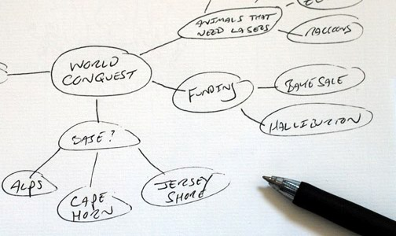

Slide 9
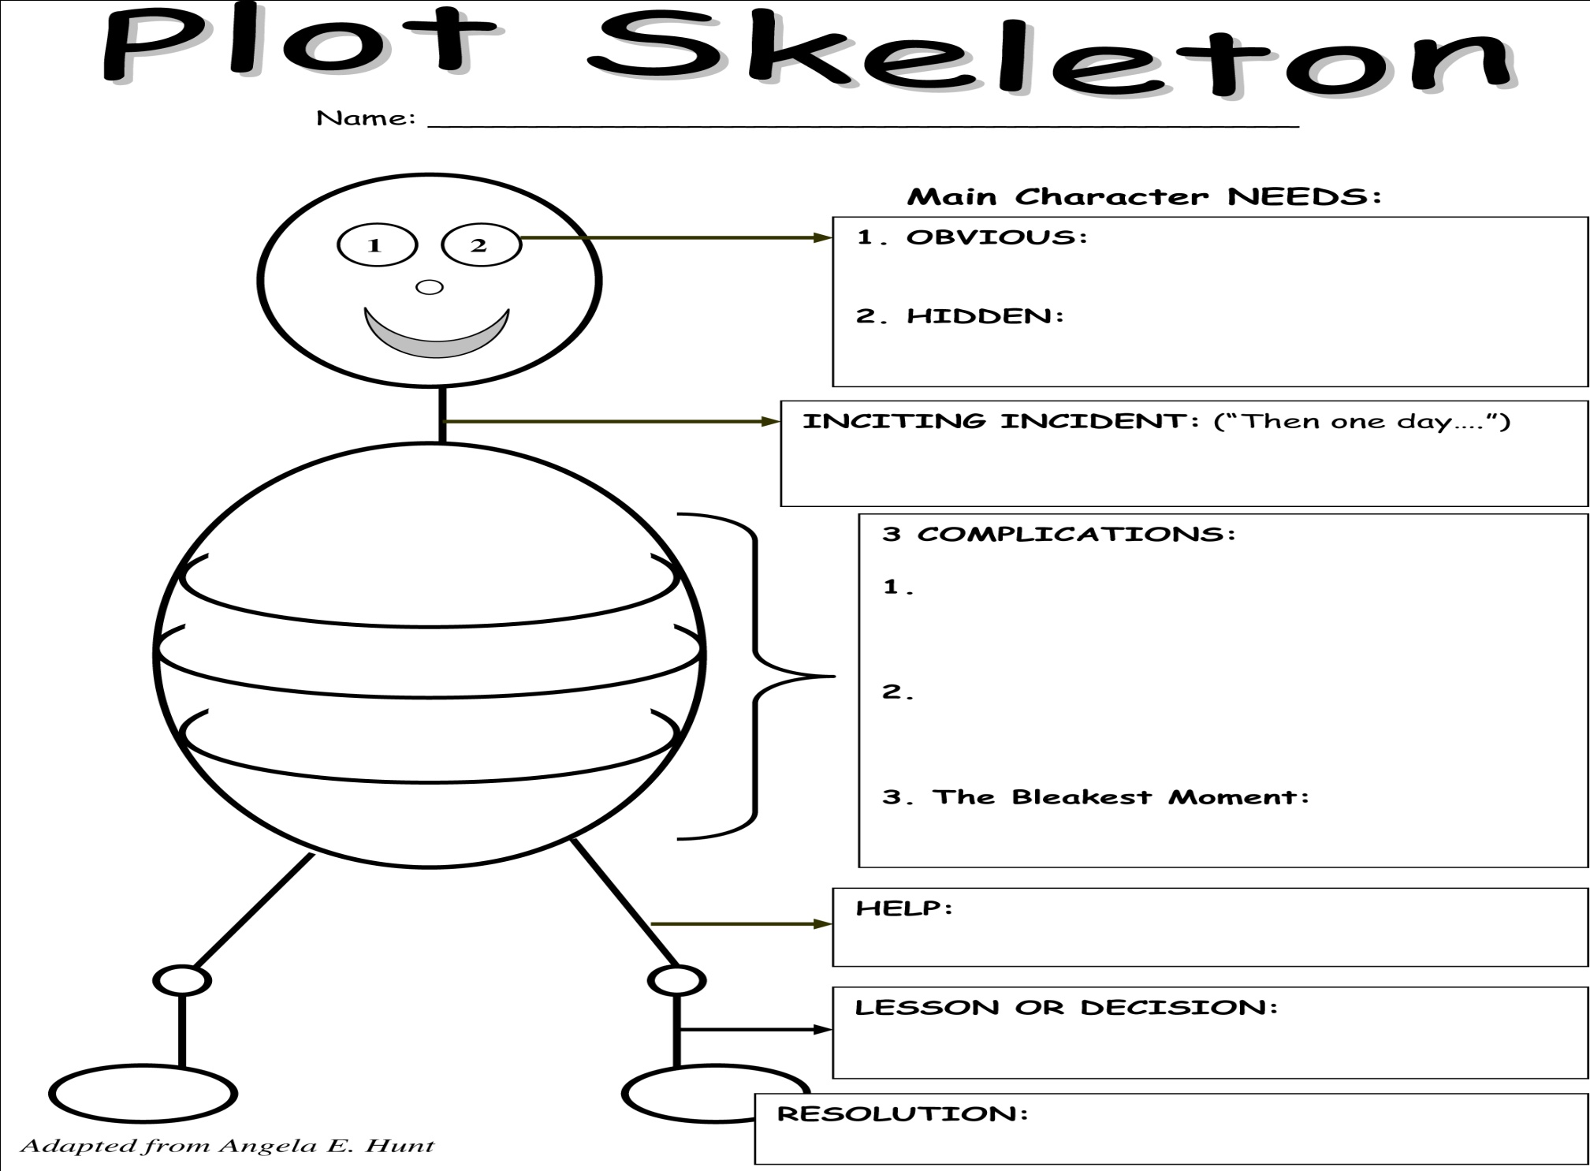

Slide 10


Slide 11
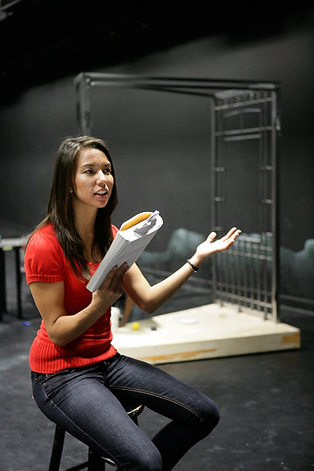

Slide 12
Performance Techniques
Map the plot as a memory technique;
Use story skeletons to help you remember the key events;
Think of the plot as a film or a series of connected images;
Tell yourself the story in your own words;
Create your own version of the story (adapt and improvise);
Retell it numerous times until it feels like a story;

Slide 13
Performance Skills
Vary the volume, pitch and tempo of your voice (enunciate clearly and exaggerate expression);
Use your face, body and gestures (let your body speak);
Make your body and face respond to the tale;
Have a clear focus and maintain concentration;
Maintain engaging eye contact with the audience/individual listeners;
Use different, exaggerated character voices;
Use your space/ be dynamic;
Remember to pace yourself;
Use silence and pauses to add dramatic effect;

Slide 14
Which of the tips did you find the most helpful?
Were there any ideas which surprised you?
Which ones would you like to try?

Slide 15
საინფორმაციო ტექნოლოგიები ინგლისური ენის
სწავლა/სწავლების პროცესში

Slide 16
Activity 1
Title | Guess the topic through the photos
Focus | Introduction of the subject: General English, module topic: Civil right movement in the USA
Stage | Lead-in
Objective | Sts will have got the main essence of the topic through describing photos related to civil right movement in the USA
Level | B2
Procedure | 1. T divides the Sts in 4 groups. T displays the topic on the table and asks the groups to find any photo through the smart phones related to the topic they are going to get to know. Groups present their photos. 2. a. T asks each group to guess what their photo shows and asks the other groups to verify the presented info in their smart phones. b. T asks Sts what they recollect about civil right movement in the USA – date, reasons, results. Recap: T asks Sts to summarize the info presented by the other group
Comments | Smart phones, photos

Slide 17
Title | Check the content
Focus | Reading
Stage | Practice
Objective | Sts will have developed reading for gist skill using application goose chase
Level | B1 and above
Procedure | T divides Sts into groups (3 or 4 depending on the number of students in the group). T writes the title of the task and asks students to open goose chase application (or register and open if they haven’t used it before) and find it. Students individually start answering the questions in writing on their smart phone screens. Teacher monitors the answers that appear on the screen of her computer. All answers appear on the screen and the leader group is identified. T checks accuracy of the answers. Recap: Groups recall the answers

Slide 18
Thanks for your attention

