Slide 1
ბიფურკაციული ანალიზი და შეკუმშული ელემენტების მდგრადობა მასალის მუშაობის დრეკად-პლასტიკურ ზონაში
გაიოზ ფარცხალაძე, გოჩა ჩავლეშვილი

Slide 2
Buckling Analysis and Stability of Compressed Low Carbon Steel Rods in Elasto-Plastic Region of Material მცირენახშირბადიანი შეკუმშული ელემენტების მდგრადობის ანალიზი მასალის მუშაობის დრეკად-პლასტიკურ არეში
Advances in Civil Engineering
Gaioz Partskhaladze¹, Ingusha Mshvenieradze², Elguja Medzmariashvili², Gocha Chavleshvili¹, Victor Yepes³, Julian Alcala³
¹Engineering and Construction Department, Batumi Shota Rustaveli State University, Batumi 6010, Georgia
²Department of Civil and Industrial Engineering, Georgian Technical University, Tbilisi 6000, Georgia
³Institute of Concrete Science and Technology (ICITECH), Universitat Politècnica de València, Valencia 46022, Spain
გაიოზ ფარცხალაძე, ინგუშა მშვენიერაძე, ელგუჯა მეძმარიაშვილი, გოჩა ჩავლეშვილი, ვიქტორ ეპესი, ხულიან ალკალა გონსალესი

Slide 3
Abstract აბსტრაქტი
This paper presents new approaches for solving a problem of the stability of compressed rods in the elasto-plastic working region of material. It is known that the columns of buildings, supports of engineering devices, the drill rods of oil and gas extraction industry may be subjected to the significant risk of stability loss. Nowadays, there are the design methods based on the test results defining the relations (e.g. critical stresses - slenderness) to avoid this risk due to stability loss, but the precision and limits of definition are not always known. The main objectives of the study were to develop new approaches that would allow specifying the values of critical stresses of compressed elements beyond the proportional limit. The problem of stability of the compressed elements in the elasto-plastic region was studied according to the stability theory. The authors suggested an original approach to the issue, in particular, the determination of values of the critical stresses and the finding of the points of the bifurcation were carried out by the tangent established by experimental results, and by the approximation of the so-called double modulus. Comparative analysis showed the advantage of the proposed approach, particularly, the new critical curves were located below the curves of Engesser-Karman and Shanley and above the critical curves established by building codes. A new approach to the determination of critical stresses in the elasto-plastic region was developed through which the structural reliability and economic efficiency was increased by almost 12 % compared to the existing approaches.
Keywords: column buckling; critical stress; axial compression steel rod; elasto-plastic region.

Slide 4
1. Introduction შესავალი
For developing modern structural, civil, mechanical and other fields of engineering, it is necessary to work out very precise calculating methods for the stability of rod systems. Researchers still have a great interest in the failure of structural elements due to the loss of stability.
A bulk-forming process from metallic materials, such as stamping, forging, extrusion and spinning is one of the main processes in industrial manufacturing. Some forging tools, such as supports, punches or ejectors may be subject to significant risk of stability loss (buckling) when they are used. Rods are used for drilling in oil and gas fields. The stability loss of the drill rod is one of the complicating factors of the drilling process, which is a major problem for oil and gas extraction industry [1]. In the seismic areas, steel frames are known as an efficient arrangement for structures. In addition, load carrying capacity of the columns as the main parts of the frame systems, using limit state design, is determined by the stability in the elasto-plastic region of material [2]. Therefore, steel columns have been widely used to dissipate seismic energy in seismic regions. These considerations are especially relevant in calculating the stability of high-rise buildings taking into account the complicated technological load on them [3, 4, 5, 6, 7, 8].
This paper presents new approaches for solving buckling problems for axially compressed columns in the elasto-plastic working region of material. A prismatic (rectangular) steel column was studied as a sample that is depicted in Fig. 1. The study of the buckling behavior of prismatic (rectangular) compressed elements is a relevant step towards understanding and assessing the reliability of more complex structures [9].

Slide 5
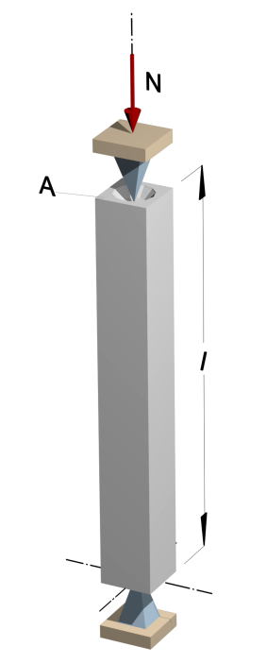
In steel columns, the issues of buckling can be divided into three types: overall buckling, local buckling, and interactive buckling [10, 11]. In prismatic columns with rectangular cross-section and medium slenderness ratio, overall buckling is normally observed first [12].
The buckling appearance (loss of stability) process was assessed with critical forces (from which the values of reduction factor are defined). The reduction factor approach defined from critical stresses appears in two alternative methods in the standards: (a) traditional method using semi-empirical design equations and (b) computer-aided method based on linear buckling analysis [12, 13].
It is common knowledge that the physical action causing the buckling of axially compressed columns is the depletion of its lateral stiffness to a value of zero. There are a number of problems in actual engineering situations, which complicate the prediction of buckling loads, e.g. initial (geometric) imperfection, material nonlinearity, loading eccentricity etc. The linear elastic Euler model of a prismatic simply supported rod still is the fundamental tool for studying buckling stability [9, 10].
In a similar way, several empirical models, for instance Engesser’s, [7, 13, 14,] are proposed in the literature to experimentally characterize the elastic-plastic and plastic buckling. Later, Shanley [9, 15] offered a different approach for defining the buckling process with its semi-empirical design equation.
In the literature [16, 17] researchers presented a numerical method for computing the load-deflection relationships of loaded square columns with various geometric parameters, loading eccentricity and column slenderness ratios.
Figure 1:
A prismatic (rectangular) pin-ended steel column

Slide 6
As mentioned above, steel frames are an efficient arrangement for structural systems in seismic regions. For this reason they have been the subject of strong research interest in recent years. In practice, earthquakes generate multidirectional ground motions, with the occurrence of yielding and buckling effects [4, 6, 8]. Previous research [3, 18] indicate how the development of local buckling restricts the ability of the members to deform plastically; also how cross section geometry influences strength, ductility and the energy absorption process.
In the literature [12] researchers examined the simply supported steel member with uniform cross-section and subjected to uniform forces. The results showed buckling resistance for such members and were standardized by the reduction factor based on the Ayrton–Perry formula [19] and calibrated by strong theoretical and empirical background. The local and overall stability of the columns through simulating their geometric and material nonlinear behavior was investigated [11]. A methodology [20] was devised to estimate the elasto-plastic properties of metallic materials from the hardness measurements using the two most frequently used sharp indenters, i.e., the Vickers indenter and the Knoop indenter. In the publication [21] researchers studied overall buckling behavior and design of high-strength steel columns. The study results indicated that with an increased of the yield strength of high-strength steel, compressive residual stresses ratio to the yield strength becomes evidently lower, possesses much less severe effects on the overall buckling behavior. Different H-shaped sections of the welded steel columns were experimentally and numerically investigated with their overall buckling behavior and their practical application was promoted [22].
The main disadvantage of the previously proposed design methods to avoid risk due to loss of stability in the elasto-plastic region was that the accuracy and limits of the definition were not always known.

Slide 7
The main objectives of the study were: (a) develop the approaches that would allow specifying the values of critical stresses of compressed elements beyond their proportional limit; (b) approximate and specify maximally the theoretical and real values of critical loads; (c) find the possible points of bifurcation in the elasto-plastic region; (d) eliminate the existence of residual deformations in the cross-section;
Eventually reduce the mass of the structure and increase its reliability.
The problem of the stability of the compressed elements was studied according to the stability theory. Methods based on the equations of equilibrium of mechanics for slightly perturbed systems around the initial position were used to study the stability.
During the study:
a) Energy method was used;
b) The principle of initial imperfections of the rod was considered;
c) Euler's analytical method was used in (during the) compression, which, in turn, was based on Hooke's Law;
d) The process of stability loss (buckling) was studied depending on the critical stresses and the slenderness ratio [12, 23, 24, 25, 26].
The advantage of the proposed approach in determining stability of compressed elements compared to the existing ones is that the critical stresses in elasto-plastic region are derived analytically and they accurately reflect the experimental data.

Slide 8
2. Stability Problem Formulation მდგრადობის პრობლემის ფორმულირება
2.1. General Aspects of Understanding Stability
მდგრადობისგაგების ზოგადი ასპექტები
Figure 2: Equilibrium Types of Deformed Body - Cantilevered column under axial force. a) Stable equilibrium; b) neutral equilibrium; c) unstable equilibrium.

Slide 9

2.2. Theoretical Analysis and Euler's Critical Curves in the Elastic Region თეორიული ანალიზი და ეილერის მრუდები დრეკად არეში
$\frac{d^{2}y}{{dx}^{2}}+\frac{N}{EI}y=0$
$N_{cr}=\frac{π^{2}EI_{min}}{l_{0}^{2}}$, $σ_{cr}=\frac{π^{2}E}{λ^{2}}$ (1)

Slide 10
Figure 3: The long slender pin-ended rod/column
Design scheme of a compressed pinned rod; b) buckling of a long slender rod; c) Free body for Euler buckling model.

Slide 11
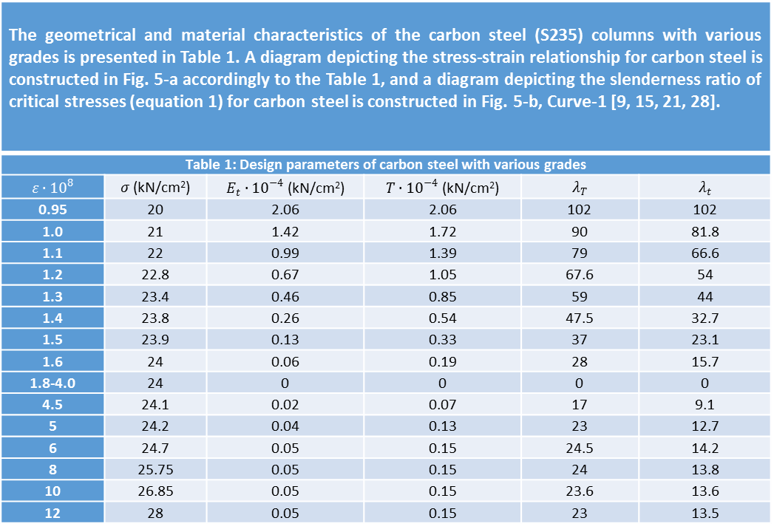
The geometrical and material characteristics of the carbon steel (S235) columns with various grades is presented in Table 1. A diagram depicting the stress-strain relationship for carbon steel is constructed in Fig. 5-a accordingly to the Table 1, and a diagram depicting the slenderness ratio of critical stresses (equation 1) for carbon steel is constructed in Fig. 5-b, Curve-1 [9, 15, 21, 28].
Table 1: Design parameters of carbon steel with various grades
$$ε∙{10}^{8}$$ | $σ$ (kN/cm²) | $E_{t}∙{10}^{−4}$ (kN/cm²) | $T∙{10}^{−4}$ (kN/cm²) | $$λ_{T}$$ | $$λ_{t}$$
0.95 | 20 | 2.06 | 2.06 | 102 | 102
1.0 | 21 | 1.42 | 1.72 | 90 | 81.8
1.1 | 22 | 0.99 | 1.39 | 79 | 66.6
1.2 | 22.8 | 0.67 | 1.05 | 67.6 | 54
1.3 | 23.4 | 0.46 | 0.85 | 59 | 44
1.4 | 23.8 | 0.26 | 0.54 | 47.5 | 32.7
1.5 | 23.9 | 0.13 | 0.33 | 37 | 23.1
1.6 | 24 | 0.06 | 0.19 | 28 | 15.7
1.8-4.0 | 24 | 0 | 0 | 0 | 0
4.5 | 24.1 | 0.02 | 0.07 | 17 | 9.1
5 | 24.2 | 0.04 | 0.13 | 23 | 12.7
6 | 24.7 | 0.05 | 0.15 | 24.5 | 14.2
8 | 25.75 | 0.05 | 0.15 | 24 | 13.8
10 | 26.85 | 0.05 | 0.15 | 23.6 | 13.6
12 | 28 | 0.05 | 0.15 | 23 | 13.5

Slide 12


2.3. Critical curves and theoretical analysis in the elasto-plastic region კრიტიკული მრუდები და თეორიული ანალიზი დრეკად-პლასტიკურ არეში
E_{t}
$$σ_{1}=+Eyρ$$
$$σ_{2}=−E_{t}yρ$$
$$σ_{0}=N/A$$
a)
b)
Figure 4. Blown up middle zone of a long slender rod
a) Free body for Euler buckling model; b) combined axial and bending stresses in a crooked column.

Slide 13
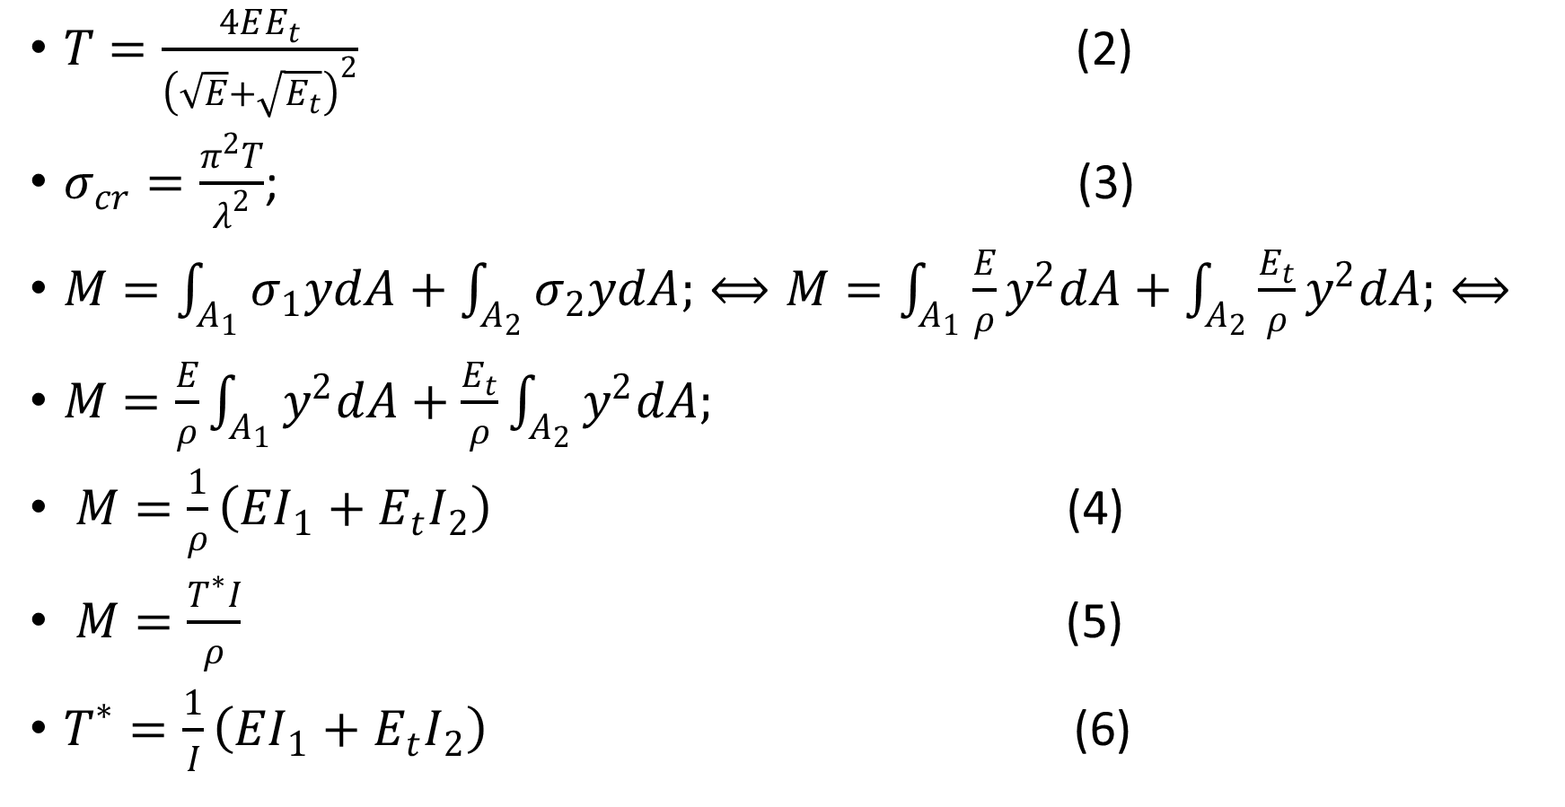
$T=\frac{4EE_{t}}{{\left(\sqrt{E}+\sqrt{E_{t}}\right)}^{2}}$ (2)
$σ_{cr}=\frac{π^{2}T}{λ^{2}}$; (3)
$M=\int_{A_{1}}{σ_{1}ydA}+\int_{A_{2}}{σ_{2}ydA;}⟺M=\int_{A_{1}}{\frac{E}{ρ}y^{2}dA}+\int_{A_{2}}{\frac{E_{t}}{ρ}y^{2}dA;}⟺$
$M=\frac{E}{ρ}\int_{A_{1}}{y^{2}dA}+\frac{E_{t}}{ρ}\int_{A_{2}}{y^{2}dA;}$
$M=\frac{1}{ρ}\left(EI_{1}+E_{t}I_{2}\right)$ (4)
$M=\frac{T^{∗}I}{ρ}$ (5)
$T^{∗}=\frac{1}{I}\left(EI_{1}+E_{t}I_{2}\right)$ (6)

Slide 14
Figure 5: Euler diagram with a real elasto-plastic behavior using a specific variation of stresses for carbon S235 steel
a) Stress-strain diagram; b) dependence of the critical stresses and the slenderness ratio
1- Euler's quadratic hyperbola; 2 - Engesser-Karman’s model; 3- Shanley’s model; 4- Authors approach; 5- model of building codes; 6- experimental data.

Slide 15
Figure 6: The cross-section of the rod

Slide 16

$E_{t}=E\left[1−{\left(\frac{σ_{crt}−σ_{el}}{σ_{y}−σ_{el}}\right)}^{2}\right]$ (7)
$σ_{cr}=\frac{π^{2}E_{t}}{λ^{2}}$ (8)

Slide 17
3. Problem Solution პრობლემის გადაწყვეტა
3.1. Choice of design loads and criteria for stability
მდგრადობის კრიტრიუმისა და საანგარიშო დატვირთვების შერჩევა.

Slide 18
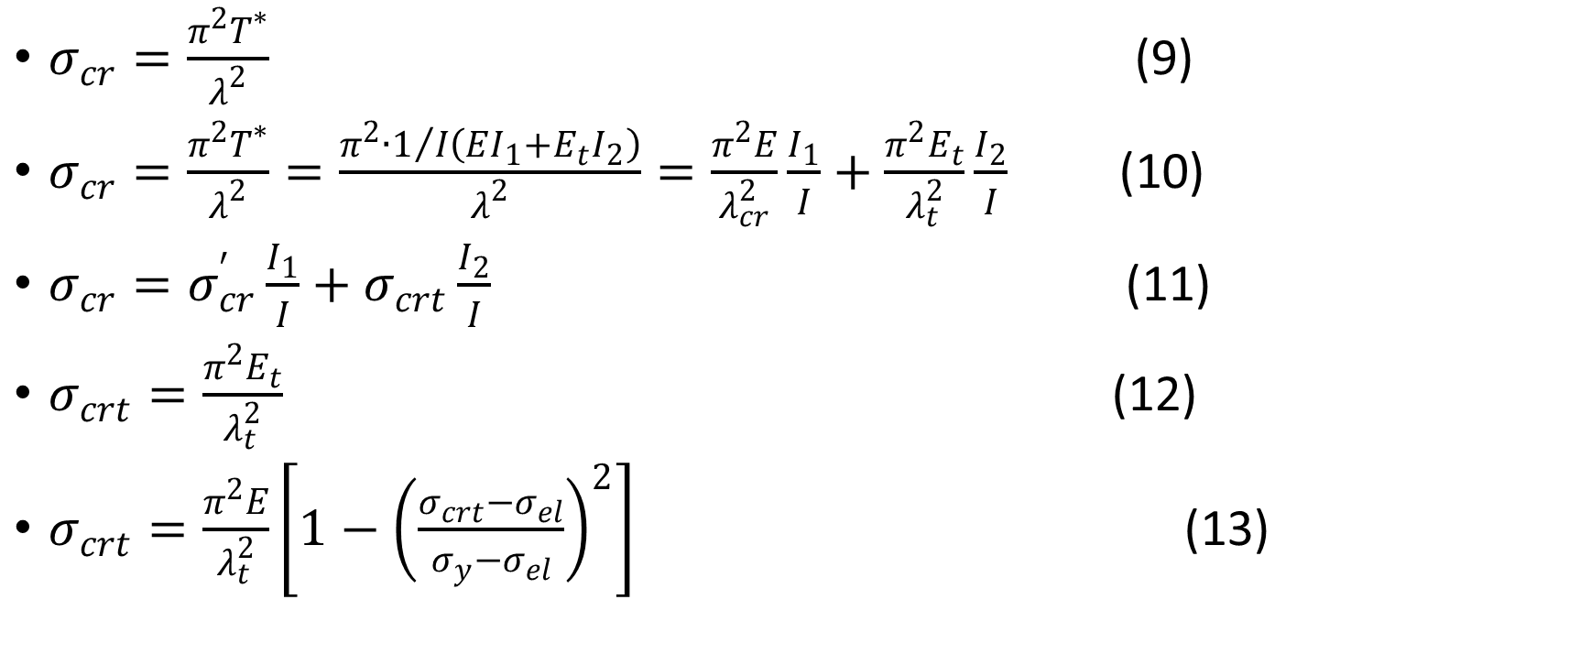
3.2. The proposed new approach for obtaining critical stresses in the elasto-plastic region, and its theoretical analysis. დრეკად-პლასტიკურ არეში ავტორების მიერ შემუშავებული კრიტიკული ძაბვების მიღების ახლებური მიდგომა და მისი თეორიული ანალიზი .
$σ_{cr}=\frac{π^{2}T^{∗}}{λ^{2}}$ (9)
$σ_{cr}=\frac{π^{2}T^{∗}}{λ^{2}}=\frac{π^{2}∙1/I\left(EI_{1}+E_{t}I_{2}\right)}{λ^{2}}=\frac{π^{2}E}{λ_{cr}^{2}}\frac{I_{1}}{I}+\frac{π^{2}E_{t}}{λ_{t}^{2}}\frac{I_{2}}{I}$ (10)
$σ_{cr}=σ_{cr}^{′}\frac{I_{1}}{I}+σ_{crt}\frac{I_{2}}{I}$ (11)
$σ_{crt}=\frac{π^{2}E_{t}}{λ_{t}^{2}}$ (12)
$σ_{crt}=\frac{π^{2}E}{λ_{t}^{2}}\left[1−{\left(\frac{σ_{crt}−σ_{el}}{σ_{y}−σ_{el}}\right)}^{2}\right]$ (13)

Slide 19
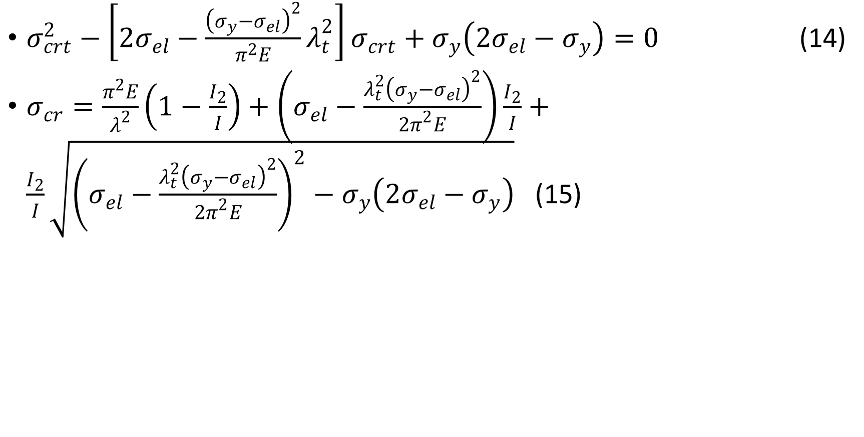
$σ_{crt}^{2}−\left[2σ_{el}−\frac{{\left(σ_{y}−σ_{el}\right)}^{2}}{π^{2}E}λ_{t}^{2}\right]σ_{crt}+σ_{y}\left(2σ_{el}−σ_{y}\right)=0$ (14)
$σ_{cr}=\frac{π^{2}E}{λ^{2}}\left(1−\frac{I_{2}}{I}\right)+\left(σ_{el}−\frac{λ_{t}^{2}{\left(σ_{y}−σ_{el}\right)}^{2}}{{2π}^{2}E}\right)\frac{I_{2}}{I}+\frac{I_{2}}{I}\sqrt{{\left(σ_{el}−\frac{λ_{t}^{2}{\left(σ_{y}−σ_{el}\right)}^{2}}{{2π}^{2}E}\right)}^{2}−σ_{y}\left(2σ_{el}−σ_{y}\right)}$ (15)

Slide 20
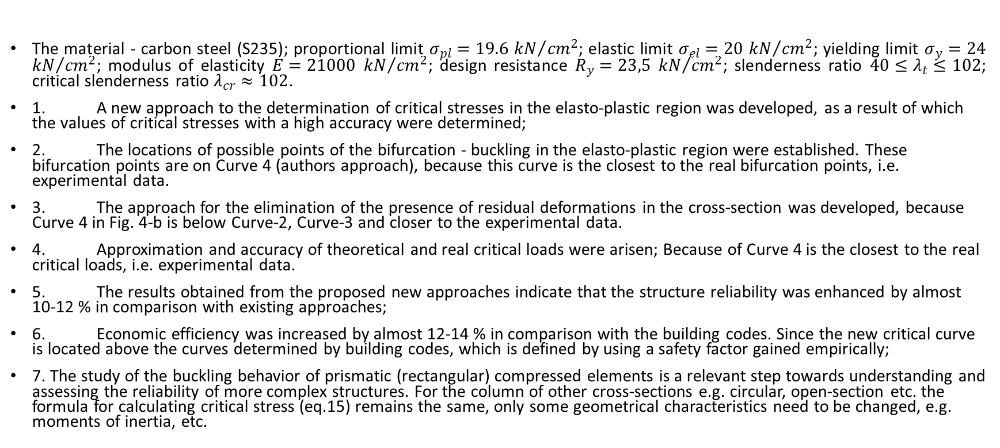
3.3. Numerical analysis რიცხვითი მაგალითი
The material - carbon steel (S235); proportional limit $σ_{pl}=19.6$ ${kN}/{{cm}^{2}}$; elastic limit $σ_{el}=20$ ${kN}/{{cm}^{2}}$; yielding limit $σ_{y}=24$ ${kN}/{{cm}^{2}}$; modulus of elasticity $E=21000$ ${kN}/{{cm}^{2}}$; design resistance $R_{y}=23,5$ ${kN}/{{cm}^{2}}$; slenderness ratio $40≤λ_{t}≤102$; critical slenderness ratio $λ_{cr}≈102$.
1. A new approach to the determination of critical stresses in the elasto-plastic region was developed, as a result of which the values of critical stresses with a high accuracy were determined;
2. The locations of possible points of the bifurcation - buckling in the elasto-plastic region were established. These bifurcation points are on Curve 4 (authors approach), because this curve is the closest to the real bifurcation points, i.e. experimental data.
3. The approach for the elimination of the presence of residual deformations in the cross-section was developed, because Curve 4 in Fig. 4-b is below Curve-2, Curve-3 and closer to the experimental data.
4. Approximation and accuracy of theoretical and real critical loads were arisen; Because of Curve 4 is the closest to the real critical loads, i.e. experimental data.
5. The results obtained from the proposed new approaches indicate that the structure reliability was enhanced by almost 10-12 % in comparison with existing approaches;
6. Economic efficiency was increased by almost 12-14 % in comparison with the building codes. Since the new critical curve is located above the curves determined by building codes, which is defined by using a safety factor gained empirically;
7. The study of the buckling behavior of prismatic (rectangular) compressed elements is a relevant step towards understanding and assessing the reliability of more complex structures. For the column of other cross-sections e.g. circular, open-section etc. the formula for calculating critical stress (eq.15) remains the same, only some geometrical characteristics need to be changed, e.g. moments of inertia, etc.

Slide 21
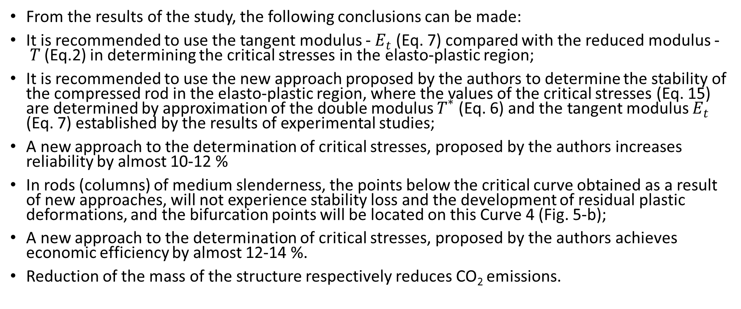
4. Conclusions დასკვნები
From the results of the study, the following conclusions can be made:
It is recommended to use the tangent modulus - $E_{t}$ (Eq. 7) compared with the reduced modulus -$T$ (Eq.2) in determining the critical stresses in the elasto-plastic region;
It is recommended to use the new approach proposed by the authors to determine the stability of the compressed rod in the elasto-plastic region, where the values of the critical stresses (Eq. 15) are determined by approximation of the double modulus $T^{∗}$ (Eq. 6) and the tangent modulus $E_{t}$ (Eq. 7) established by the results of experimental studies;
A new approach to the determination of critical stresses, proposed by the authors increases reliability by almost 10-12 %
In rods (columns) of medium slenderness, the points below the critical curve obtained as a result of new approaches, will not experience stability loss and the development of residual plastic deformations, and the bifurcation points will be located on this Curve 4 (Fig. 5-b);
A new approach to the determination of critical stresses, proposed by the authors achieves economic efficiency by almost 12-14 %.
Reduction of the mass of the structure respectively reduces CO₂ emissions.

Slide 22
Acknowledgments სამადლობელი წერილი
The research described in this paper was financially supported by the Erasmus Mundus Action 2 Project “Electra: Enhancing Learning in ENPI Countries through Clean Technologies and Research related Activities” (Project: ELEC1400294), and the Spanish Ministry of Economy and Competitiveness, along with FEDER funding (Project: BIA2017-85098-R).

Slide 23
References ლიტერატურა
D. J. Braun, “On the optimal shape of compressed rotating rod with shear and extensibility”, International Journal of Non-Linear Mechanics, vol. 43, no. 2, pp. 131-139, Article ID https://doi.org/10.1016/j.ijnonlinmec.2007.11.001, 2008.
B. Rossi and K. J. R. Rasmussen, “Carrying Capacity of Stainless Steel Columns in the Low Slenderness Range”, Journal of Structural Engineering, vol. 139, no. 6, pp. 1088–1092, Article ID https://doi.org/10.1061/(ASCE)ST.1943-541X.0000666, 2013.
X. Cheng, Y. Chen, L. Niu and D. A. Nethercot, “Experimental study on H-section steel beam-columns under cyclic biaxial bending considering the effect of local buckling”, Engineering Structures, vol. 174, pp. 826–839, Article ID https://doi.org/10.1016/j.engstruct.2018.08.001, 2018.
Y. Goto, M. Muraki and M. Obata, “Ultimate State of Thin-Walled Circular Steel Columns under Bidirectional Seismic Accelerations”, Journal of Structural Engineering, vol. 135, no. 12, pp. 1481–1490, Article ID https://doi.org/10.1061/(ASCE)ST.1943-541X.0000076, 2009.
M. J. Leamy, “Wave Based Analysis of Buckling in Columns and Frames”, ASME. International Design Engineering Technical Conferences and Computers and Information in Engineering Conference, vol. 8: 22nd Reliability, Stress Analysis, and Failure Prevention Conference; 25th Conference on Mechanical Vibration and Noise, Article ID https://doi.org/10.1115/DETC2013-12926, 2013.
J. Lu, B. Wu and Y. Mei, “Buckling mechanism of steel core and global stability design method for fixed-end buckling-restrained braces”, Engineering Structures, vol. 174, pp. 447–461, Article ID https://doi.org/10.1016/j.engstruct.2018.07.024, 2018.
A. G. Razdolsky, “Revision of Engesser’s Approach to the Problem of Euler Stability for Built-Up Columns with Batten Plates”, Journal of Engineering Mechanics, vol. 140, no. 3, pp. 566–574, Article ID https://doi.org/10.1061/(ASCE)EM.1943-7889.0000677, 2014.
D. G. Zapata-Medina, L. G. Arboleda-Monsalve and J. D. Aristizabal-Ochoa, “Static Stability Formulas of a Weakened Timoshenko Column: Effects of Shear Deformations”, Journal of Engineering Mechanics, vol. 136, no.12, pp.1528–1536, Article ID https://doi.org/10.1061/(ASCE)EM.1943-7889.0000193, 2010.
A. Ziółkowski and S. Imiełowski, “Buckling and Post-buckling Behaviour of Prismatic Aluminium Columns Submitted to a Series of Compressive Loads”, Experimental Mechanics, vol. 51, no. 8, pp. 1335–1345, Article ID https://doi.org/10.1007/s11340-010-9455-y, 2010.
P. Li, X. Liu and C. Zhang, “Interactive buckling of cable-stiffened steel columns with pin-connected crossarms”, Journal of Constructional Steel Research, vol. 146, pp. 97–108, Article ID https://doi.org/10.1016/j.jcsr.2018.03.037, 2018.

Slide 24
L. Yang, G. Shi, M. Zhao, and W. Zhou, “Research on interactive buckling behavior of welded steel box-section columns”, Thin-Walled Structures, vol. 115, pp. 34–47, Article ID https://doi.org/10.1016/j.tws.2017.01.030, 2017.
F. Papp, “Buckling assessment of steel members through overall imperfection method”, Engineering Structures, vol. 106, pp. 124–136, Article ID https://doi.org/10.1016/j.engstruct.2015.10.021, 2016.
P. D. Simão, “Influence of shear deformations on the buckling of columns using the Generalized Beam Theory and energy principles”, European Journal of Mechanics - A/Solids, vol. 61, pp. 216–234, Article ID https://www.sciencedirect.com/science/article/pii/S0997753816303096, 2017.
X.-F. Li, and K. Y. Lee, “Effects of Engesser’s and Haringx’s Hypotheses on Buckling of Timoshenko and Higher-Order Shear-Deformable Columns”, Journal of Engineering Mechanics, vol. 144, no.1, pp. 04017150, Article ID https://doi.org/10.1061/(ASCE)EM.1943-7889.0001363, 2018.
J. Becque, Inelastic Plate Buckling, Journal of Engineering Mechanics, vol. 136, no. 9, pp. 1123–1130, Article ID https://doi.org/10.1061/(ASCE)EM.1943-7889.0000075, 2010.
M. Ahmed, Q. Liang, V. I. Patel and M. N. S. Hadi, “Nonlinear analysis of rectangular concrete-filled double steel tubular short columns incorporating local buckling”, Engineering Structures, vol. 175, pp.13–26, Article ID https://doi.org/10.1016/j.engstruct.2018.08.032. 2018
Y.-L. Long, L. Zeng, “A refined model for local buckling of rectangular CFST columns with binding bars”, Thin-Walled Structures, vol.132, pp. 431–441, Article ID https://doi.org/10.1016/j.tws.2018.09.019, 2018.
C. D. Moen, A. Schudlich and A. von der Heyden, “Experiments on Cold-Formed Steel C-Section Joists with Unstiffened Web Holes”, Journal of Structural Engineering, vol. 139, no. 5, pp. 695–704, Article ID https://doi.org/10.1061/(ASCE)ST.1943-541X.0000652, 2013.
J. Szalai, “Complete generalization of the Ayrton-Perry formula for beam-column buckling problems”, Engineering Structures, vol. 153, pp. 205–223, Article ID https://doi.org/10.1016/j.engstruct.2017.10.031,2017.
C. Zhang, F. Li and B. Wang, “Estimation of the elasto-plastic properties of metallic materials from micro- hardness measurements”, Journal of Materials Science, vol. 48, no.12, pp. 4446–4451, Article ID https://link.springer.com/article/10.1007%2Fs10853-013-7263-3, 2013.
https://doi.org/10.1007/s00170-014-6146-3, 2014.

Slide 25
H. Ban and G. Shi, “Overall buckling behaviour and design of high-strength steel welded section columns”, Journal of Constructional Steel Research, vol.143, pp.180–195, Article ID https://doi.org/10.1016/j.jcsr.2017.12.026, 2018.
T.-Y. Ma, Y.-F. Hu, X. Liu et al., “Experimental investigation into high strength Q690 steel welded H-sections under combined compression and bending”, Journal of Constructional Steel Research, vol. 138, pp. 449–462, Article ID https://doi.org/10.1016/j.jcsr.2017.06.008, 2017.
A. Kervalishvili and I. Talvik, “Modified procedure for buckling of steel columns at elevated temperatures”, Journal of Constructional Steel Research, vol. 127, pp. 108–119, Article ID https://doi.org/10.1016/j.jcsr.2016.07.008, 2016.
T. Tankova, J. P. Martins, L. Simões da Silva et al., “Experimental lateral-torsional buckling behaviour of web tapered I-section steel beams”, Engineering Structures, vol.168, pp. 355–370, Article ID https://doi.org/10.1016/j.engstruct.2018.04.084, 2018.
N. Tullini, A. Tralli and D. Baraldi, “Buckling of Timoshenko Beams in Frictionless Contact with an Elastic Half-Plane”, Journal of Engineering Mechanics, vol.139, no. 7, pp. 824–831, Article ID https://doi.org/10.1061/(ASCE)EM.1943-7889.0000529, 2013.
B. Xie, J. Hou, Z. Xu and M. Dan, “Component-based model of fin plate connections exposed to fire-part I: Plate in bearing component”, Journal of Constructional Steel Research, vol. 149, pp.1–13, Article ID https://doi.org/10.1016/j.jcsr.2018.07.011, 2018
J. D. Aristizabal-Ochoa, “Stability of columns with semi-rigid connections including shear effects using Engesser, Haringx and Euler approaches”, Engineering Structures, vol. 33, no.3, pp. 868–880, Article ID https://doi.org/10.1016/j.engstruct.2010.12.008, 2011.
F. M. Mitenkov, V. G. Bazhenov, V. K. Lomunov et al., “Effects of elasticity, plasticity, and geometrical nonlinearity in problems of static and dynamic bending of plates”, Doklady Physics, vol. 56, no.12, pp. 622– 625, Article ID https://doi.org/10.1134/S102833581112010X, 2011.
J. Bielski, B. Bochenek, “On a compressed elastic–plastic column optimized for post-buckling behaviour”, Engineering Optimization, vol. 40, no.12, pp. 1101–1114, Article ID https://doi.org/10.1080/03052150802313365, 2008.
O. Fergani, I. Lazoglu, A. Mkaddem, M. El Mansori et al.,“Analytical modeling of residual stress and the induced deflection of a milled thin plate”, The International Journal of Advanced Manufacturing Technology, vol. 75, no.1–4, pp. 455–463, Article ID https://doi.org/10.1007/s00170-014-6146-3, 2014.

