Slide 1
Inter-cultural and Inter-semiotic Transformation of Universal Values
In Western and Oriental Contexts
Financed by Ministry of Education, Culture and Sport
Autonomous Republic of Adjara
Ketevan Svanidze
Batumi Shota Rustaveli State University,
PhD, Associate professor
ketevan.svanidze@bsu.edu.ge
Nino Phartenadze
Batumi Shota Rustaveli State University, PhD
Phartenadze.nino@gmail.com

Slide 2

Translation – Intercultural Dialogue
Successful Communication – target texts maintains cultural
and linguistic specifications ensuring the target reader
to experience the source text culture
Unsuccessful communication - source text fails cultural transformation, metamorphism, after which target reader only learns about foreign culture and its space

Slide 3

Translation as means of national and universal value manifesto
Values:
  world vision
  Social Norms
  Verbal and nonverbal forms of interrelation
  Behavior, chivalry, heroism
  Affection, love and etc.

Slide 4
Roman Jakobson “On Linguistics aspects of Translation”, 1959
Translation
Intralingual
Interlingual
Intersemiotic
rewording is an interpretation of verbal signs by means of other signs of the same language.
Proper Translation
interpretation of verbal signs by means of some other language
Transmutation, interpretation of the verbal signs by means of signs of nonverbal sign system. as we know Semiotics is study of signs and symbols one sign to another

Slide 5
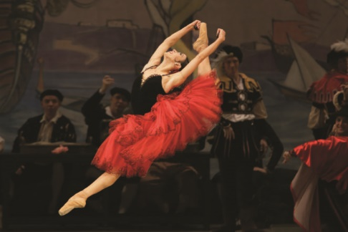
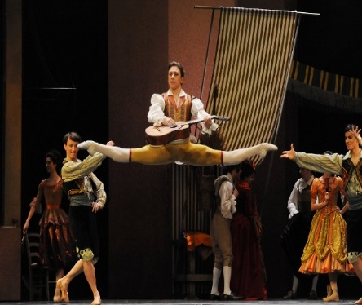
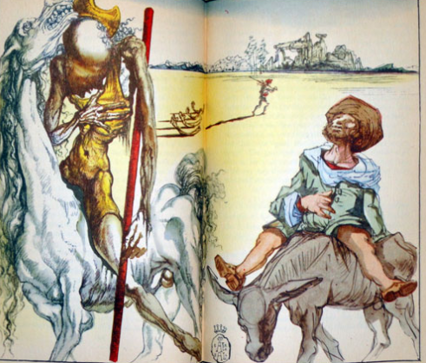
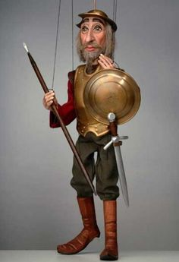
Intersemiotic Translation:
Illustration (graphical design of the book, comics, full illustration without the verbal text);
Screening (animated films, parody movies, TV series, ballet movies);
Stage Performance (a puppet show, a play, a musical, opera and ballet performances);

Slide 6

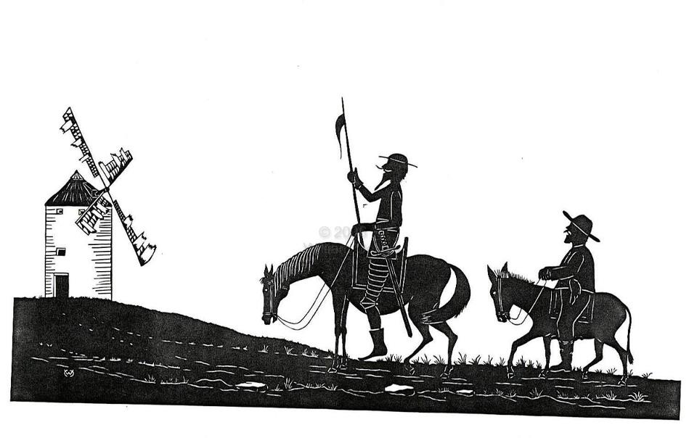
1. Verbal Text analysis
3. Comparative analysis
2. Intersemiotic Translation/ Screening

Slide 7
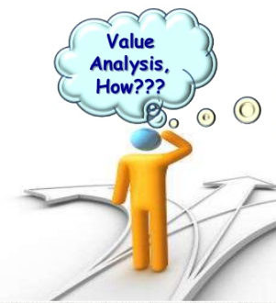
1. Verbal Text Analysis
Familiarized with the verbal text – not the source Text (NO Interlingual Translation);
Distinguished the values that were and are characteristic for the European World;

Slide 8
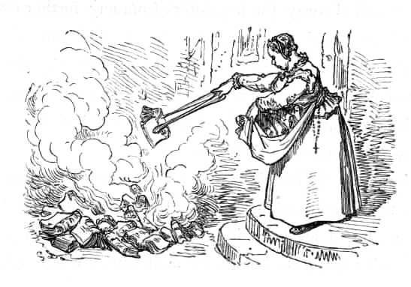
2. Screening – Intersemiotic Transformation Product
Screening – secondary text as a intersemiotic transformation (so called Intersemiotic Translation) product, i.e. the interpretation of verbal sign by means of signs of non verbal sign system

Slide 9
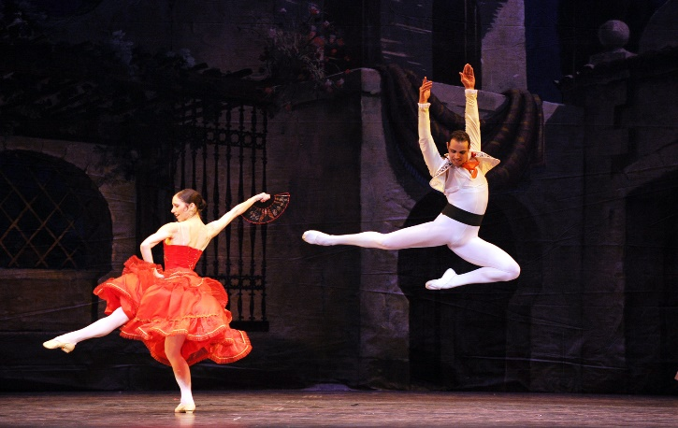
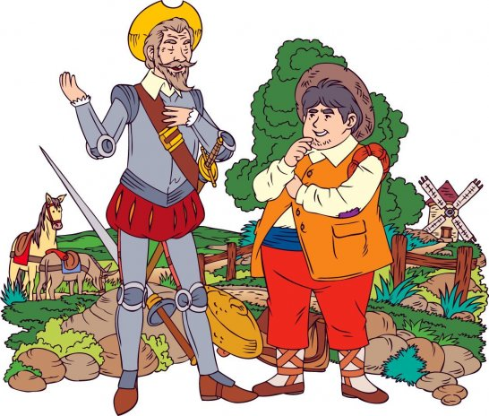
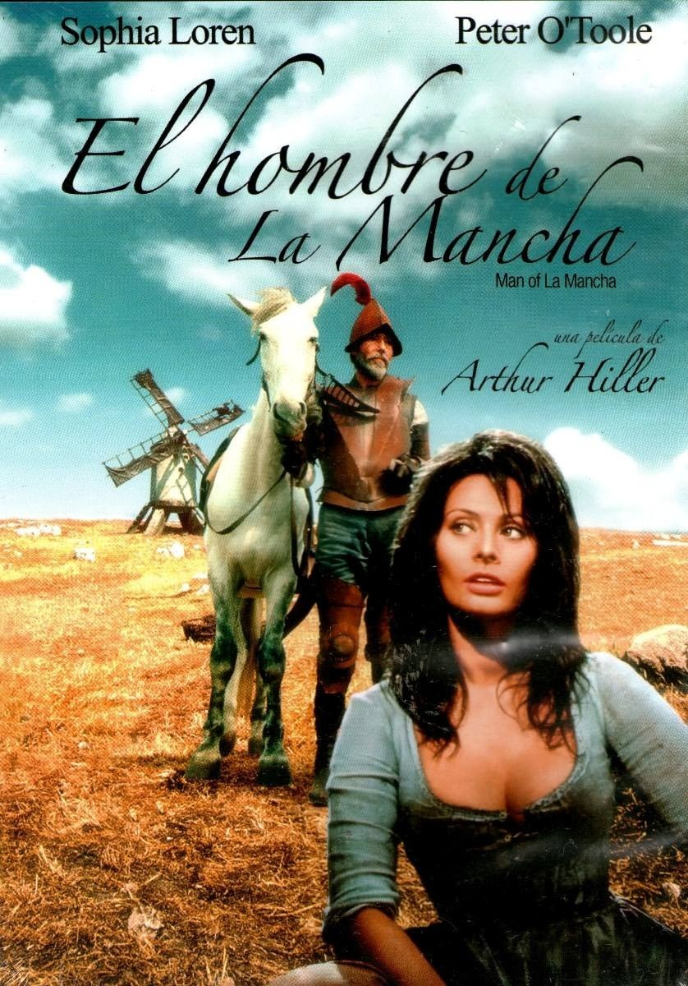
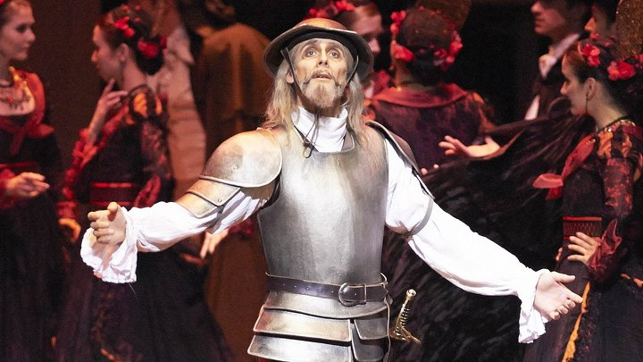
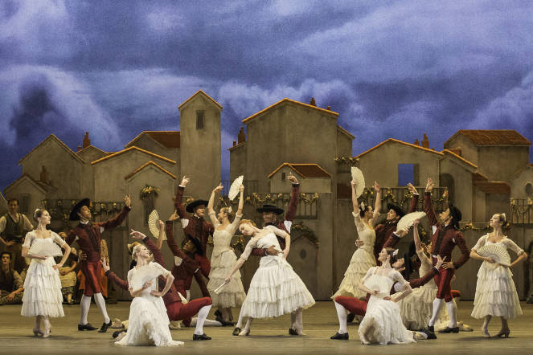
Variety of Intersemiotic Translation
Don Quixote
New Jersey Film Ballet, 2011
Animated films
Silent Films
Stage Performance
Drama, 1972
Film Opera, Royal Opera House

Slide 10
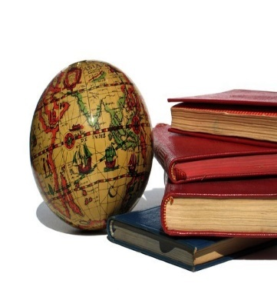
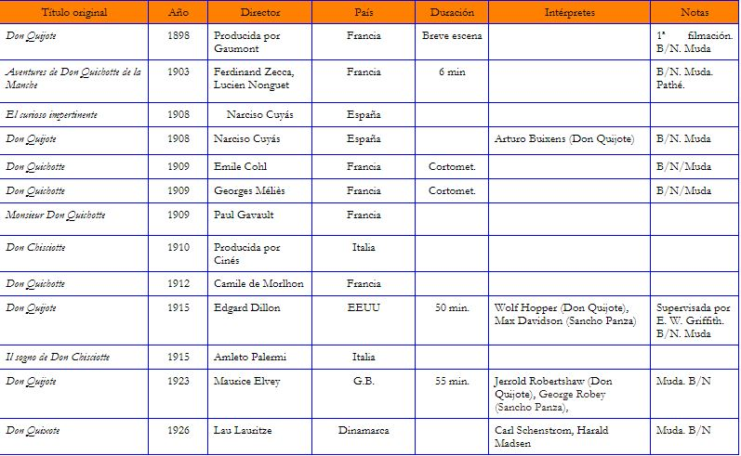
Over 70 Screenings of Don Quixote Around the Globe 1903 - 2018

Slide 11
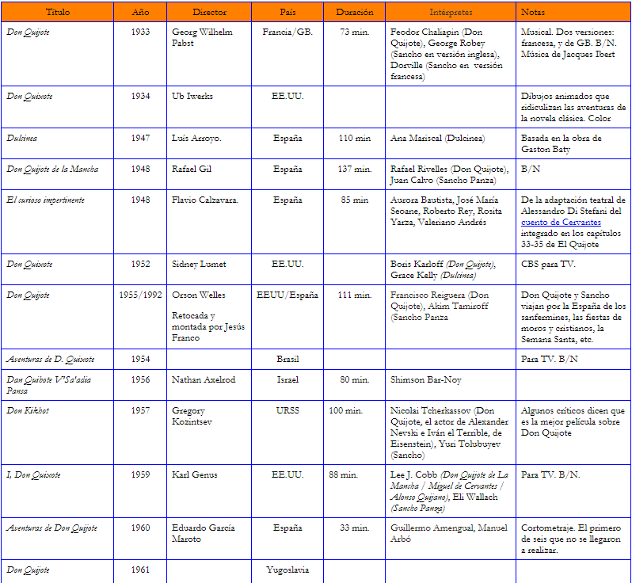
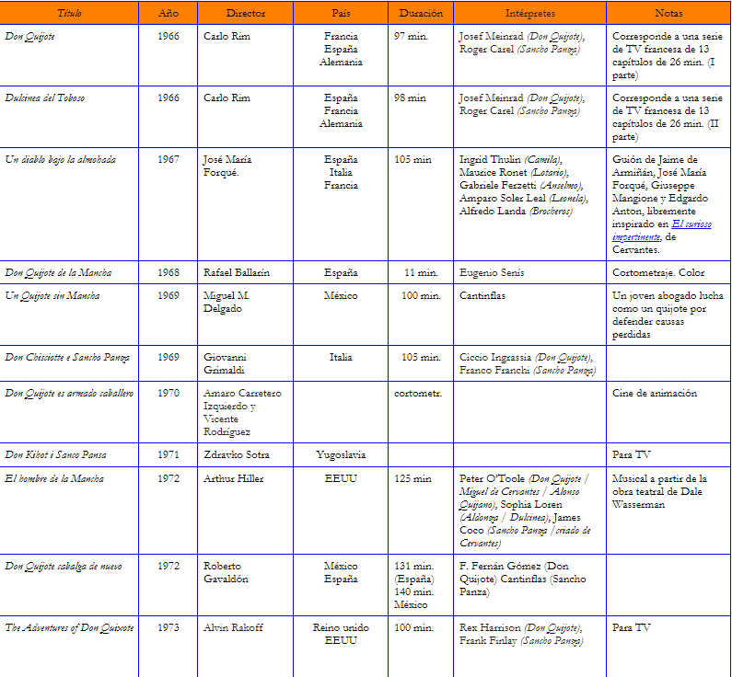

Slide 12
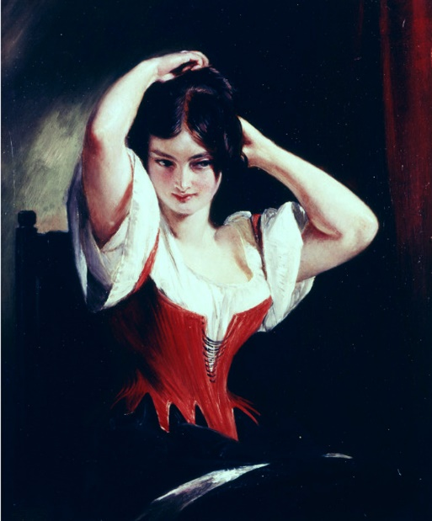
Dulcinea Del Toboso
The Peasant Mistress of Don Quixote, 1839

Slide 13
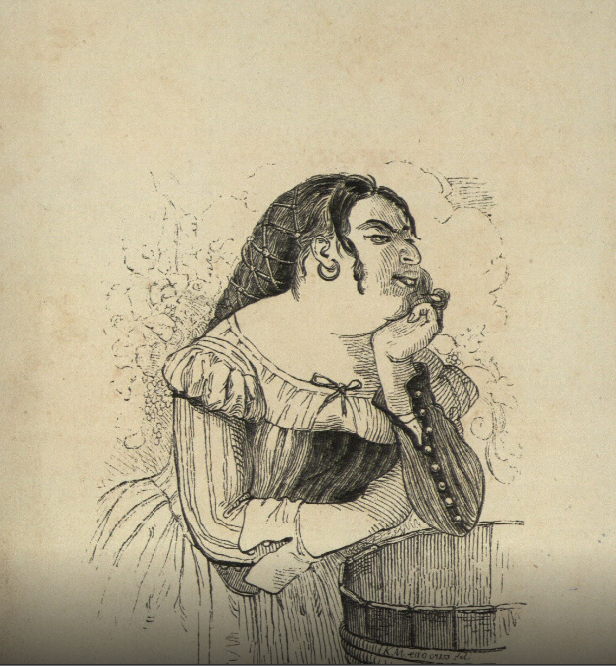
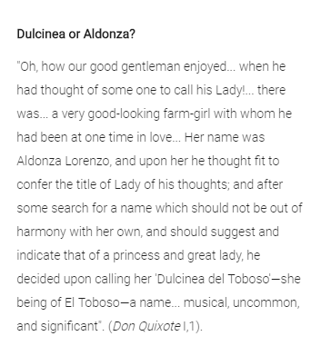
The female world in Don Quixote
The quixotic world of women covers a broad spectrum of the society of his time that includes peasants, prostitutes, shepherdesses, duchesses, men disguised as women, serving wenches or land ladies with beards.

Slide 14
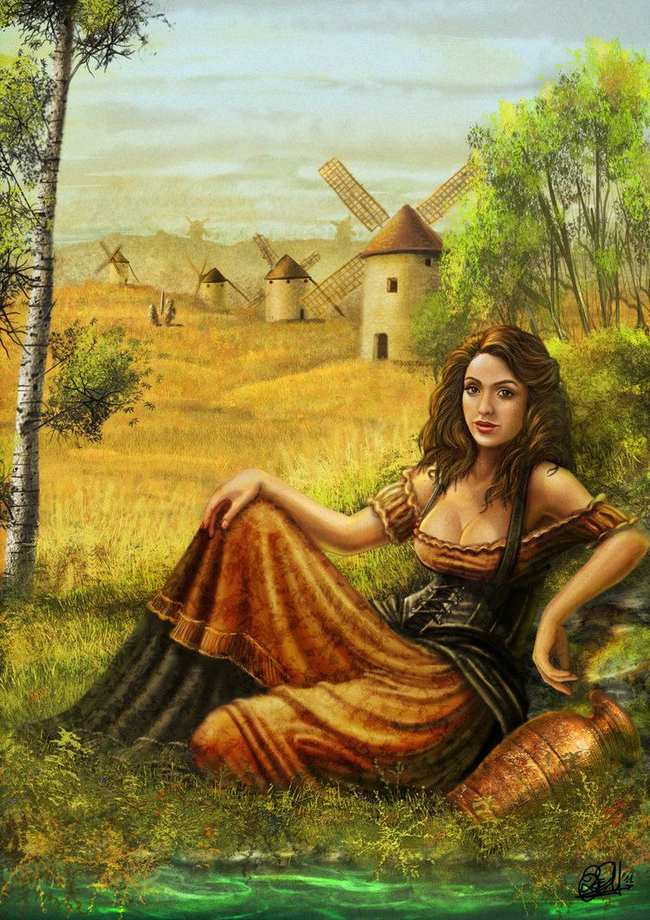
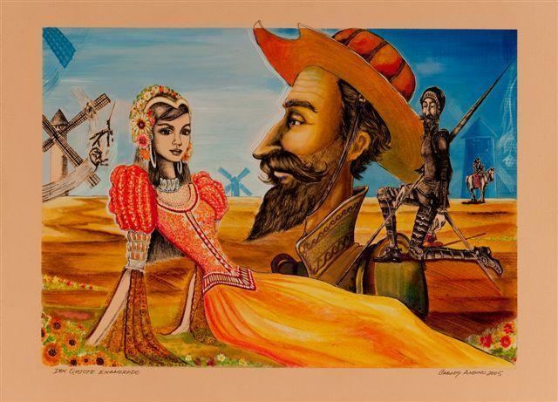
General Perception of Dulcinea’s Beauty
“Oh, how our good gentleman enjoyed the delivery of his speech, especially when he had thought of some one to call his lady! There was, so the story goes, in a village near his own a very good-looking farm-girl with whom he had been at one time in love, though, So far is known, she never knew it nor gave a thought to the matter. Her name was Aldonza Lorenzo, and upon her he thought fit to confer the title of Lady of his Thoughts; and after some search for a name which should not be out of harmony with her own, Should suggest and indicate that of a princess and great lady, he decided upon calling her Dulcinea Del Toboso – she being of El Toboso – a name, to his mind, musical, uncommon, and significant, like all those he had already bestowed upon himself and the things belonging to him.”

Slide 15
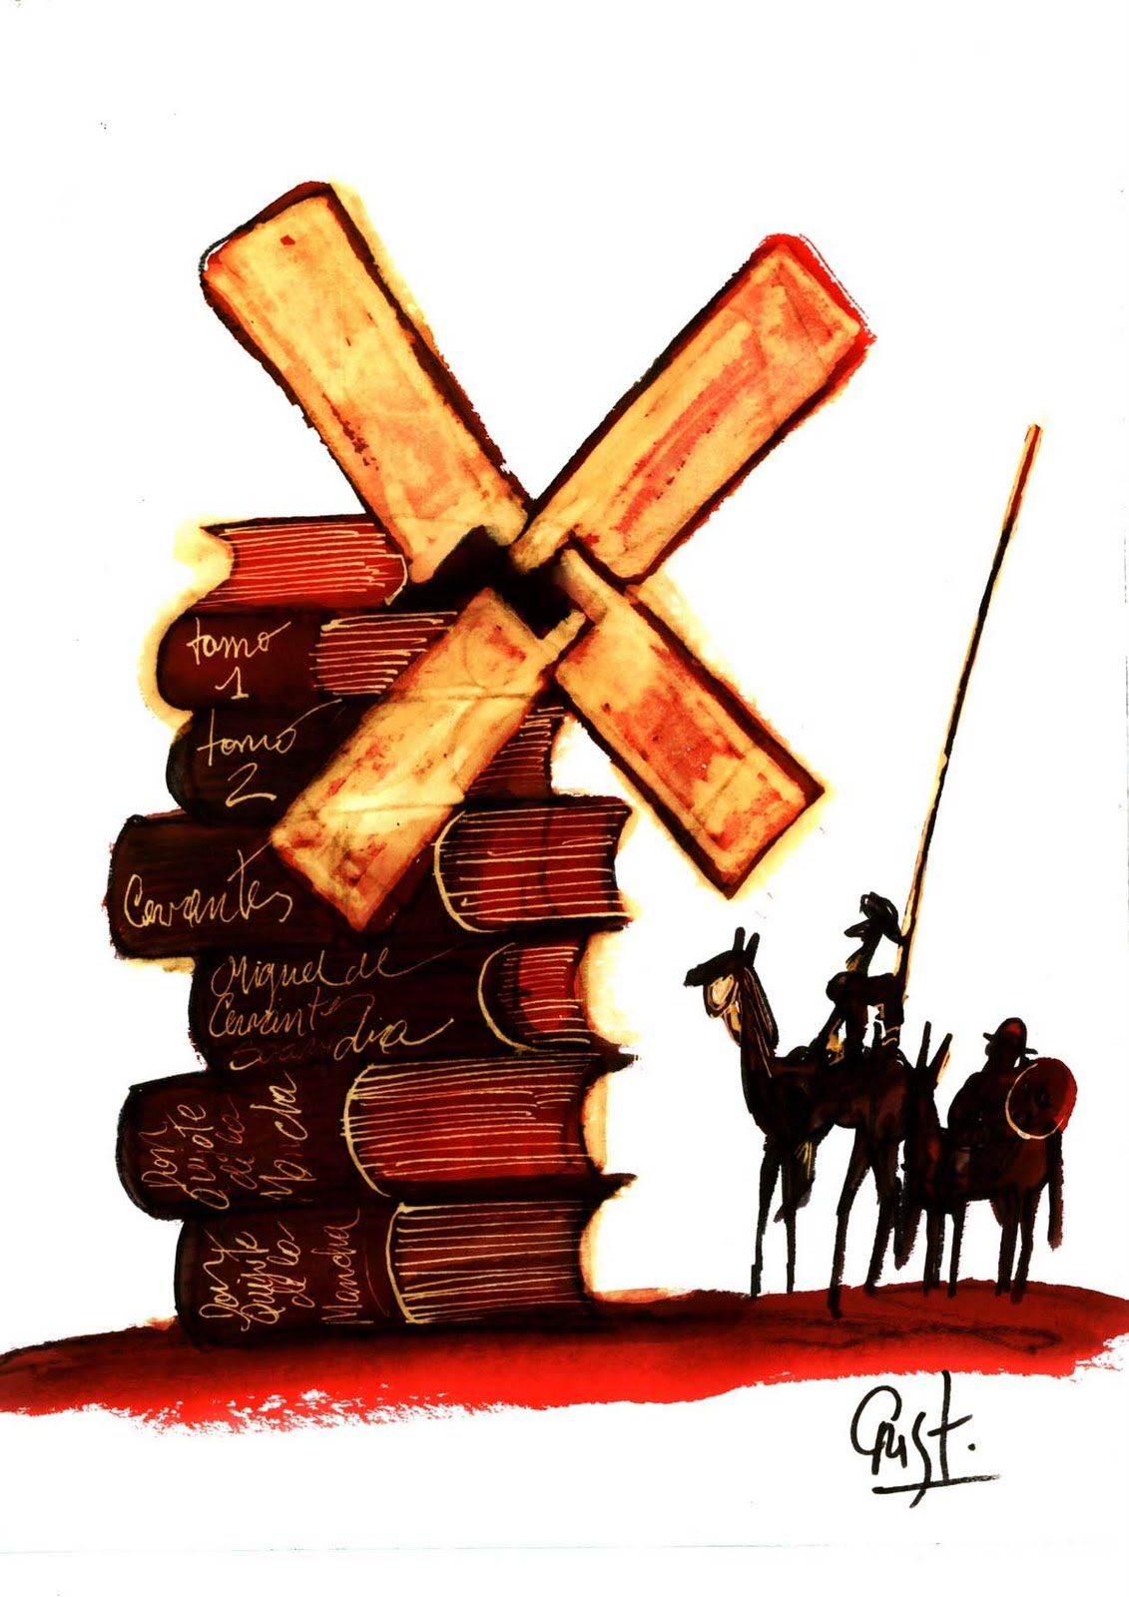
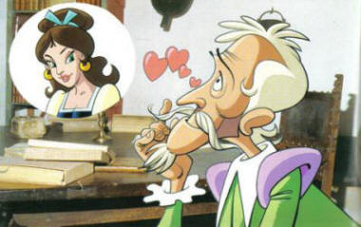
Verbal Text Compression – Semiotic Null
The verbal text is not sounded in entirety

Slide 16
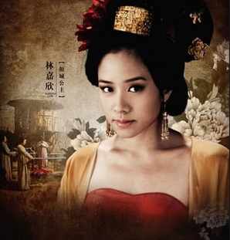
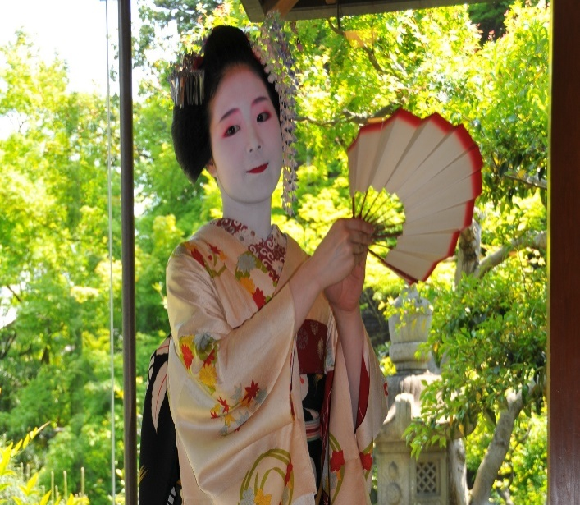
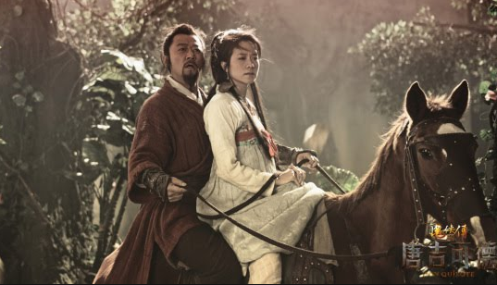
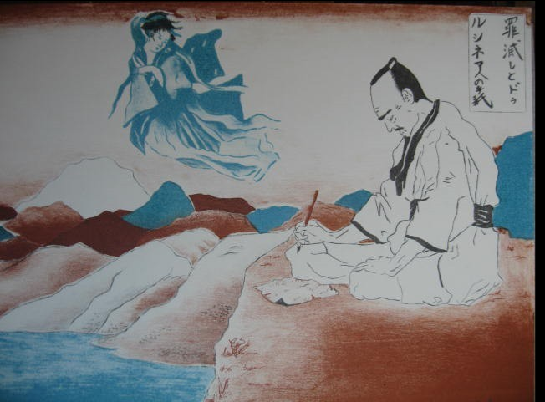
Different Perception of Beauty,
Eastern Culture

Slide 17
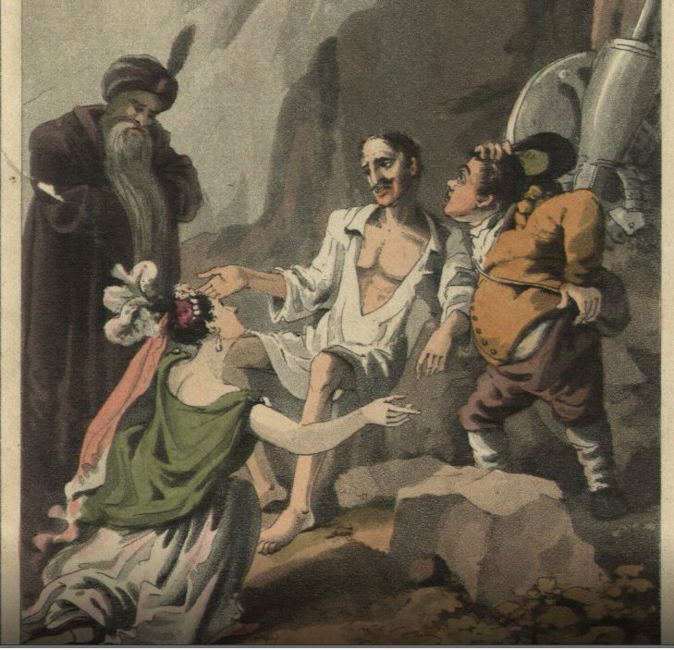
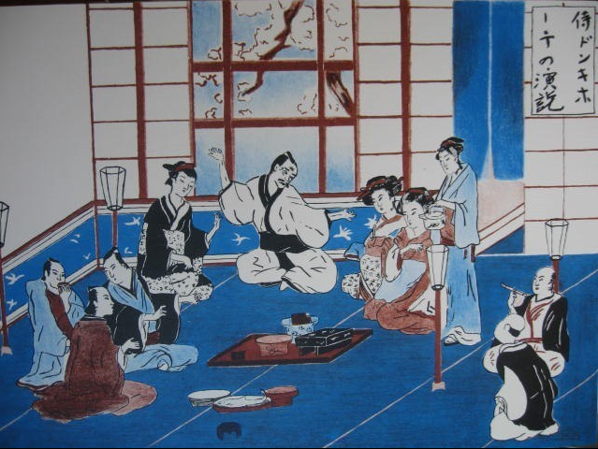
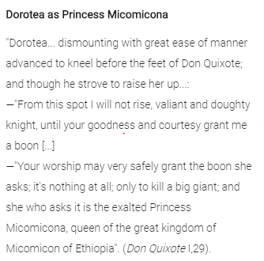
Visualization & cultural adaptation
Verbal text = intersemiotic translation with
cultural adaptation

Slide 18
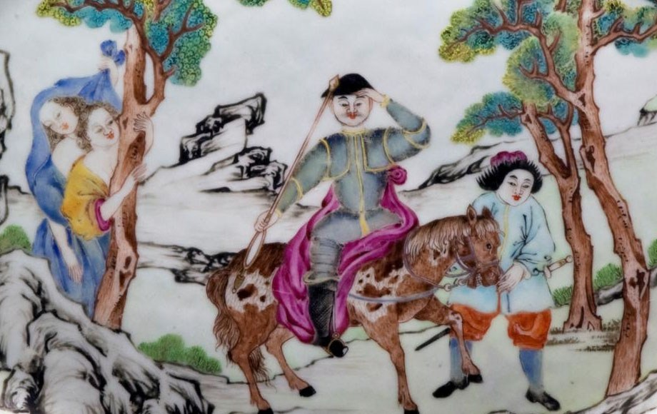
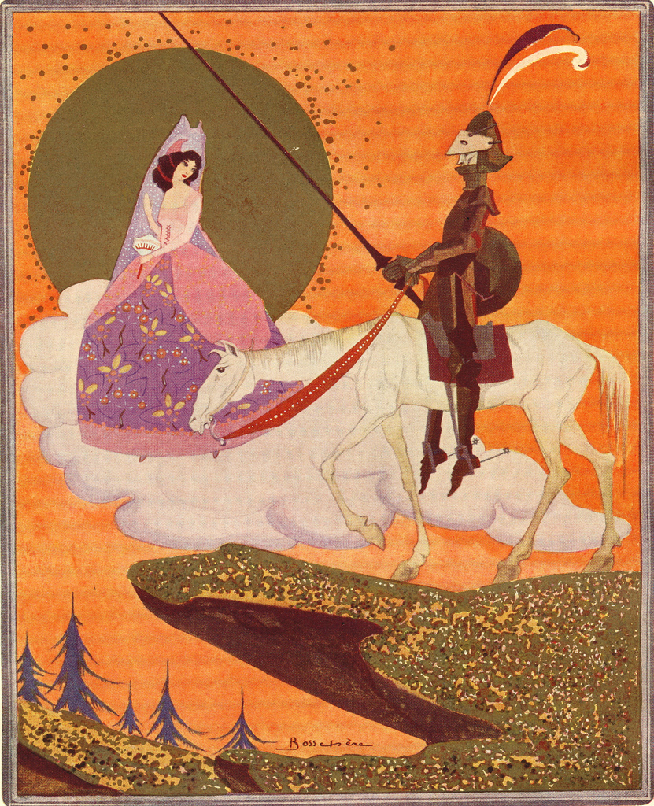
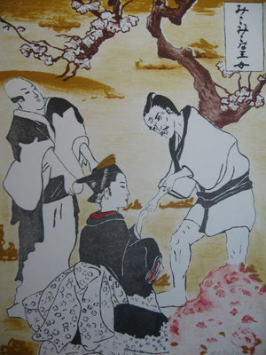
Female Virtue difference in
W & E culture
Chinese
≠
‗
Japanese

Slide 19
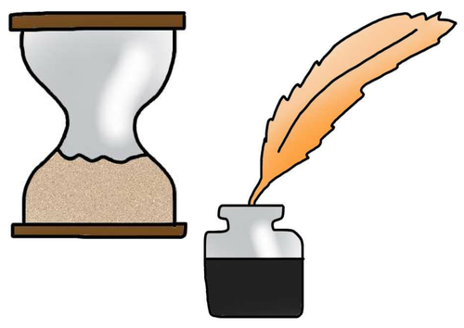
Conclusion
Everything in West is similar
Everything in East is similar
West differs from/ not same to East.
Japanese (Eastern) values match to western values – western values are clearly outlined in Japanese screening adapted by eastern culture.
The ignorance of western values is revealed in Chinese screening. They are used as vital representing tool (art of fighting) and element of Chinese Culture.

Slide 20

Thank You!

