Slide 1
BATUMI SHOTA RUSTAVELI STATE UNIVERSITY
Georgia

Slide 2


Slide 3

IN MIXED-LEVEL CLASSES

Slide 4

class with students having the same linguistic levels, abilities learning styles or preferences

Slide 5
PROBMEMS:
At universities students are grouped or placed according to their performance on the national entrance exams or, later, on standardized placement tests
At schools students’ foreign language level completely depends on the age and correspondingly the grade they are in.

Slide 6
RESULT:
Students’ level vary considerably in language courses and it causes a number of problems for teachers and students. Taking into account the common teacher-centered or one-book-fits-all approach, where the teacher is forced to focus on the middle level, many students at the top or bottom end of the language scale are left dissatisfied or demotivated.

Slide 7
ACTIONS TAKEN:
Teachers have to become more students-oriented by providing comprehensible input, using a variety of teaching methods and materials, providing interesting and challenging tasks in a student’s focused – environment.
Teachers should work on more students- oriented and differentiated approach that provides a more level- appropriate, and motivating learning experience for all students in the class regardless of their level.

Slide 8
Simple Equation:
Text level of challenge + task level of support = student success
Tiered Tasks and Bias Tasks.

Slide 9
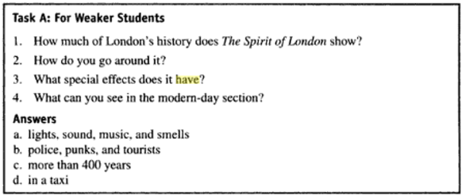
When dealing with reading for weak students it might be a matching task to be used:

Slide 10
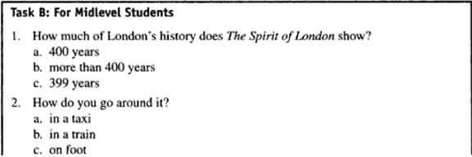
With midlevel students multiple choice questions with more than one correct answer:

Slide 11
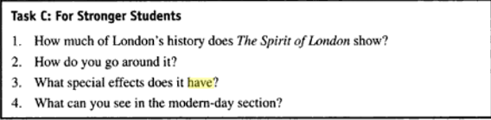
With strong students open questions to make the task more challenging for them:

Slide 12
This way tiered tasks produce the same or similar results for all students.

Slide 13
Experts also offer to let students choose the tasks according to whether they want a lot of help, some help, or no help at all with the reading activity.

Slide 14
Bias tasks produce complementary results-
For example weaker students write answers to the questions whenever stronger students write questions for the given answers.
Because the answers to these two tasks are complementary, it would be better to economize time by using student-student (strong+ weak) feedback.
The teacher should monitor and check in case some strong students have come up with alternative questions of their own.

Slide 15
Differentiated work-
to assign different work to different people.

Slide 16
Jim Scrivener offers one more option when teaching mixed-level classes dividing the class (separating the different levels out)
1 Make short-term pairs or threes for a single task, deliberately mixing stronger and weaker students together.
2. Make long term pairs, threes or groups for a months or half term, each including one stronger student who is openly given the task of guiding and supporting the other students.
3. Divide the class into two halves or more subdivisions if it is useful for some parts each lesson.

Slide 17
Split- and- combine workflow
Split and- combine workflow is the technique where the whole class starts work on something together, and later in the lesson, different subsections of the class separate off to do different work, maybe the same tasks at a different pace, or tasks that have a similar focus, but with different language levels. These groups later come back together and so on.

Slide 22
This discussion results in the following outcomes:
still we see the necessity of raising teachers awareness of the techniques used to deal with students of different needs in class.
An acknowledgement of many educational problems in the areas of differentiated work leads us to realize that teachers have to be trained so they may welcome, initiate and thus control change.

Slide 23
We base our discussion on several points:
Individualization in mixed ability classes requires that educational objectives remain the same, but that content materials differ to meet individual needs.
Teachers will need to adapt instructional materials to individual learning.
All this will result in hugely improved dynamics and pace of the class; increased motivation, enjoyment and interaction.

Slide 24
References
[1] J. Scrivener, Classroom management Techniques Cambridge University Press, 2013.
[2] J. C. Richards; W. A. Renandya, Methodology in Language Teaching An Anthology of Current Practice Cambridge university Press, 2008.
[3] V. Kelly, TEACHING MIXED ABILITY CLASSES. London: Harper & Row, 1974. 125

