Slide 1


Swedish
Government
Scholarships
available for Citizens of Georgia
Embassy of Sweden in Tbilisi

Slide 2

Citizens of Georgia
May apply for VISBY
Region Scholarships.
The Region Unites:
Georgia;
Ukraine;
Azerbaijan;
Armenia;
Belarus;
Moldova;
Russia.
Statistics
Each year around 50-60 applicants from Georgia are granted with various scholarships:
30-40 leadership programs;
4-6 Peer Shadowing;8
12 Master Studies;
2-4 PhD and Post-Doc Researches;

Slide 3

Scholarships are granted by Swedish Institute – SI
SI is a government agency that promotes interest and
trust in Sweden around the world.
For Question why Sweden we may say:
Fully funded scholarships
(tuition, accommodation, insurance, travel);
Flexible Schedule (sandwich model 3/6/12 months);
Best material and digital learning materials;
Conditions of living and studying;
Engagement in alumni networks.

Slide 4


Scholarships are granted in the frames of project
“Study In Sweden” run by Swedish Institute.

Slide 5
3 types of Scholarships:
VISBY Scholarships – Master, PhD and Post-Doc;
Leadership Scholarships – SAYP (Summer Academy for Young participants) and BALTICLEAD (Sustainable Entrepreneurship Program);
Professional Exchange – PEER SHADOWING (available only for SAYP alumnus)
Additionally SI offers
Special Funding and Grants
Alumni Grants
All info on www.si.se

Slide 6
Dates:
VISBY Scholarships – Open December - February;
Leadership Scholarships – Open Feb/March-May;
Professional Exchange – Open all year round
Additionally SI offers
Special Funding and Grants – depend on
Alumni Grants - Open all year round
All info on www.si.se

Slide 7
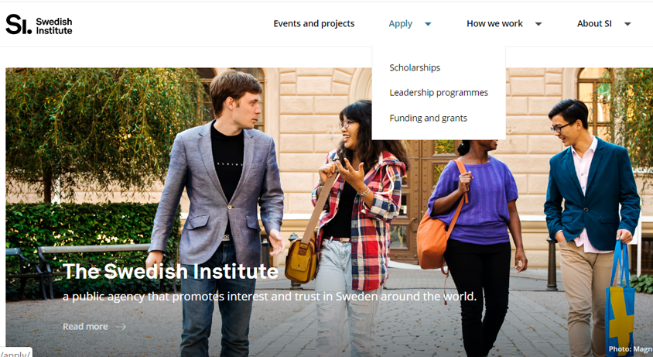

Slide 8

Full scholarship / Application fee – 900 SEK up to 4 positions
– Travel (5000 SEK),
+ VISBY grant (studying fee + insurance)
+ Scholarship:
Master around 9000 SEK (900 EUR),
PHD – 18000 SEK,
Post-doc / Senior Researcher – 21000 SEK
Whole process done by means of online portal - www.universityadmissions.se
Info: www.si.se
Contact us: https://www.facebook.com/swedenalumninetworkgeorgia/

Slide 9
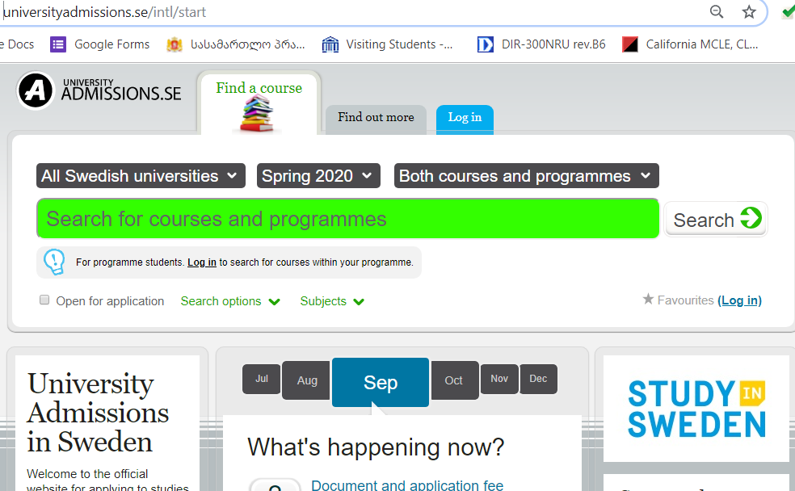

Slide 10
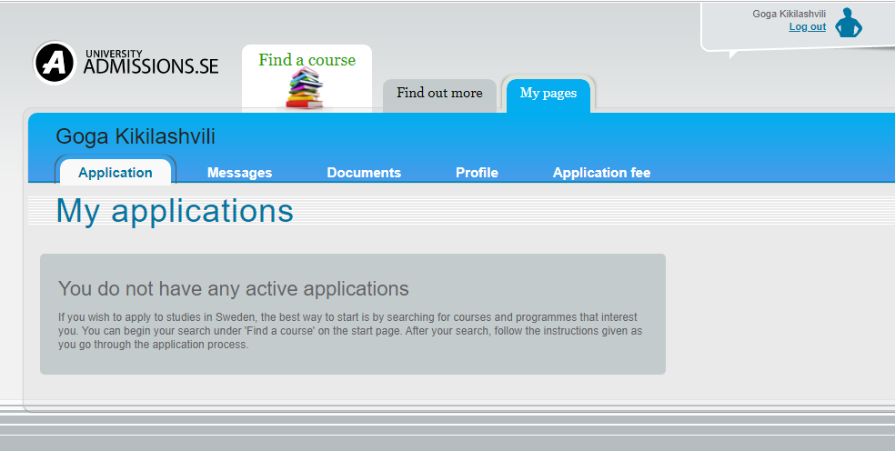

Slide 11

For Additional Information
You may contact
Sweden Alumni
Network Georgia
on Facebook Page
Since 25 Nov. 2019
Contact
https://www.facebook.com/swedenalumninetworkgeorgia/

Slide 12

Thank You for attention !

