Slide 1

Handling Multy-level classes

Slide 2

There are no classes with students having the same linguistic levels, abilities learning styles or preferences

Slide 3
PROBMEMS:
At universities students are grouped or placed according to their performance in the national entrance exams or, later, in standardized placement tests
At schools students’ foreign language level completely depends on the age and correspondingly the grade they are in.
Although the movement, in which students are viewed as possessing individual learning needs, started long time ago, teachers and students are still struggling with the same problem.

Slide 4
The most important issue:
Many students are left dissatisfied or demotivated because of the common teacher-centered or one-book-fits-all approach.

Slide 5
Two points to work on
To learn much about multi-level classes.
To find out whether other teachers in the area are aware of the problem and techniques used to deal with them.

Slide 6
Simple Equation:
Text level of challenge + task level of support = student success
Tiered Tasks and Bias Tasks.

Slide 7
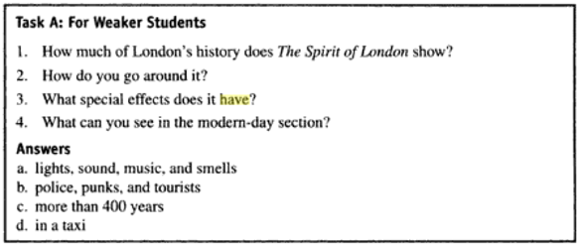
When dealing with reading for weak students it might be a matching task to be used:

Slide 8
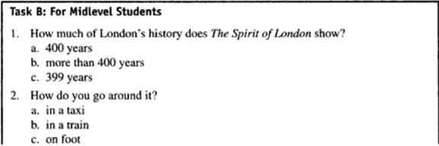
With midlevel students multiple choice questions with more than one correct answer:

Slide 9
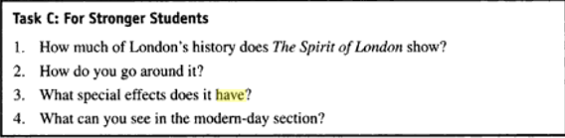
With strong students open questions to make the task more challenging for them:

Slide 10
This way tiered tasks produce the same or similar results for all students.
Hence, the process leads to the final goals that are appropriate and satisfying for both teachers and students

Slide 11
Experts also offer to let students choose the tasks according to whether they want a lot of help, some help, or no help at all with the reading activity.

Slide 12
Bias tasks produce complementary results-
For example weaker students write answers to the questions whenever stronger students write questions for the given answers.
Because the answers to these two tasks are complementary, it would be better to economize time by using student-student (strong+ weak) feedback.
The teacher should monitor and check in case some strong students have come up with alternative questions of their own.

Slide 13
Differentiated work-
to assign different work to different people.

Slide 14
Jim Scrivener offers one more option when teaching mixed-level classes dividing the class (separating the different levels out)
1 Make short-term pairs or threes for a single task, deliberately mixing stronger and weaker students together.
2. Make long term pairs, threes or groups for a months or half term, each including one stronger student who is openly given the task of guiding and supporting the other students.
3. Divide the class into two halves or more subdivisions if it is useful for some parts each lesson.

Slide 15
Split- and- combine workflow
Split and- combine workflow is the technique where the whole class starts work on something together, and later in the lesson, different subsections of the class separate off to do different work, maybe the same tasks at a different pace, or tasks that have a similar focus, but with different language levels. These groups later come back together and so on.

Slide 16
ACTIONS TAKEN:
The traditional approach, based on which teachers tend to polarize a class into two parts: stronger, high ability, fast learners and the opposite weaker, low ability, slow learners, needs to be abandoned at last.
Teachers have to become more students-oriented by using a variety of teaching methods and materials, providing interesting and challenging tasks in a student’s focused – environment.
Teachers should work on more students- oriented and differentiated approach.

Slide 21
Discussion and implication
Based on the data collected we can conclude that differentiated work requires much and thorough thinking and preparation from the part of a teacher, which becomes quite time consuming at times
teachers try to deal with mixed- level classes using mostly class division technique into groups or pairs
The third chart reveals that teachers sometimes or almost rarely let their students choose what to do
The final chart shows that just a few teachers apply other techniques in their multi- level classes

Slide 22
This discussion results in the following outcomes:
still we see the necessity of raising teachers awareness of the techniques used to deal with students of different needs in class.
An acknowledgement of many educational problems in the areas of differentiated work leads us to realize that teachers have to be trained so they may welcome, initiate and thus control change.

Slide 23
We base our discussion on several points:
Individualization in multi-level classes requires that educational objectives remain the same, but that content materials differ to meet individual needs.
The key strategies for teaching mixed level classes are probably developing a positive and collaborative working atmosphere and providing a variety of work suitable for different levels.
All this will result in hugely improved dynamics and pace of the class; increased motivation, enjoyment and interaction.

Slide 24
References
Bremner, S. (2008). Teaching a mixed ability class. Retrieved from https://www.languageswithoutlimits.co.uk/resources/sbremner.pdf
Hadfield, J., Hadfield, C. (2008) Introduction to teaching English, Oxford University press. (148-149)
Kelly, V. (1974) Teaching mixed ability classes: an individualized approach. London: Harper & Row,. 125Jack C. (Review) 96-97
Rees, G. (2003)Teaching mixed-ability classes 1. British Counsil. Retrived from https://www.teachingenglish.org.uk/article/teaching-mixed-ability-classes-1
Rees, G.(2003) Teaching mixed-ability classes 2. British Counsil. Retrived from. https://www.teachingenglish.org.uk/article/teaching-mixed-ability-classes-2
Richards, J. C., Renandya, W. A. (2008) Methodology in Language Teaching An Anthology of Current Practice , Cambridge university Press. (59-63) Retrieved from https://viancep2012.files.wordpress.com/2011/12/methodology_in_language_teaching_2002_scanned.pdf
Richards, J. C., Theodore, S. Rogers. (2001) Approaches and Methods in Language Teaching. Second Edition. Cambridge University Press. 115-123
Scrivener, J. (2013) Classroom management Techniques. Cambridge University Press. 88-107
Wilkinson, D. (2012). Student-centered activities in mixed-level classes. In A. Stewart & N. Sonda (Eds.), JALT2011 Conference Proceedings. Tokyo: JALT. Retrieved from https://jalt-publications.org/files/pdf-article/jalt2011-061.pdf

