Slide 1







EU programme “Support to Georgia’s Researchers’ Mobility”
&
EU ENI East Twinning project “Supporting inter-sectoral collaboration possibilities between
Research and Industry”
Selecting and advertising HEU Calls for Georgian Stakeholders
This slides were created with the support of the European Union, which does not necessarily mean that it reflects the views of the European Union.
Only contractors are responsible for the content of the publication.

Slide 2
Step 1: Find the right HEU Calls
Published Working Programmes: https://ec.europa.eu/info/funding-tenders/opportunities/portal/screen/opportunities/topic-search
  + Several thematically sorted documents, covering one specific area of HE (e.g. Health, Widening…)
  + Information are available way in advance (eventually you can get even access to Draft WP’s)
  - No filter options available
Search Mask: https://ec.europa.eu/info/funding-tenders/opportunities/portal/screen/how-to-participate/reference-documents
  + Diverse filtering options
  + always up to date
  - calls only visible when published
  - no central document
Dedicated events/webinars: depending on host organisation
  + Calls are presented and explained
  + Possibilty to ask questions
  - only at a certain time

Slide 3
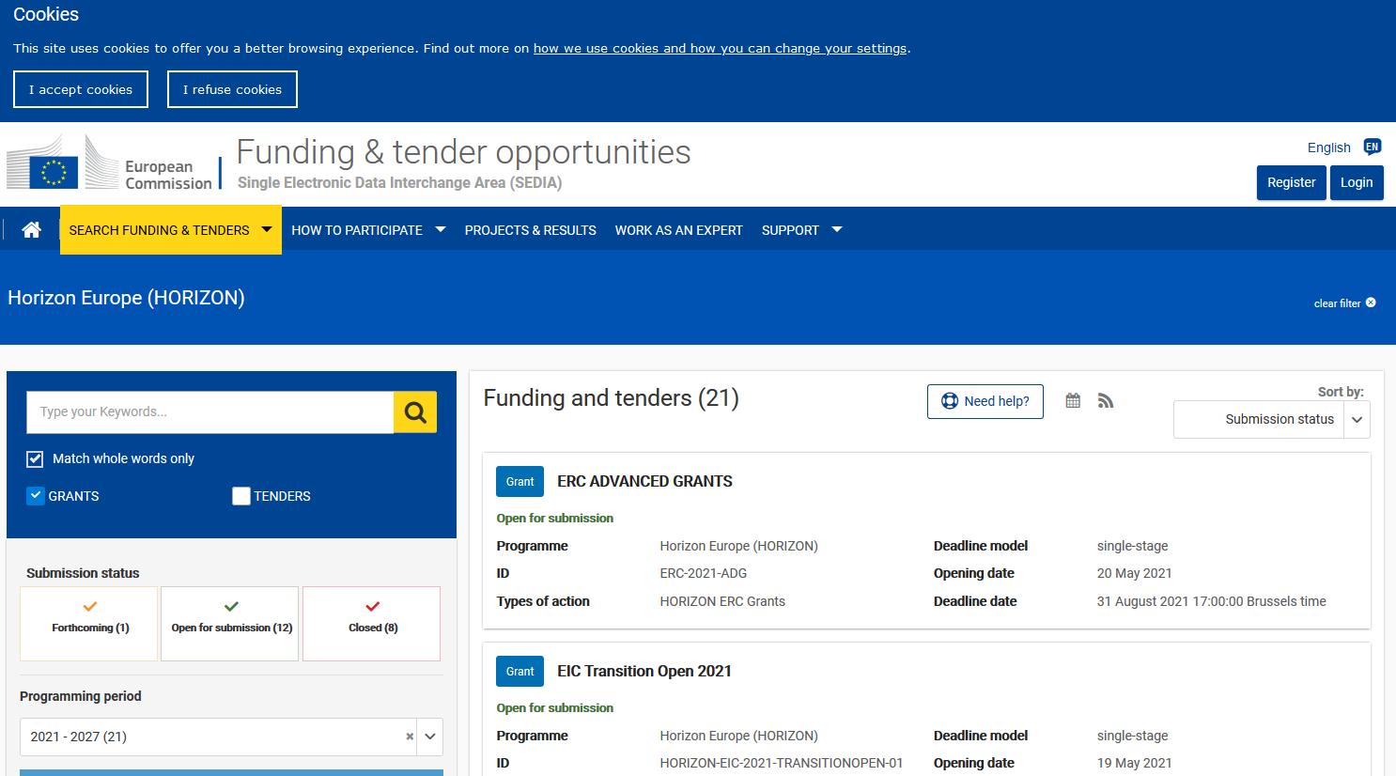
Funding and Tenders Portal (Search Mask)

Slide 4
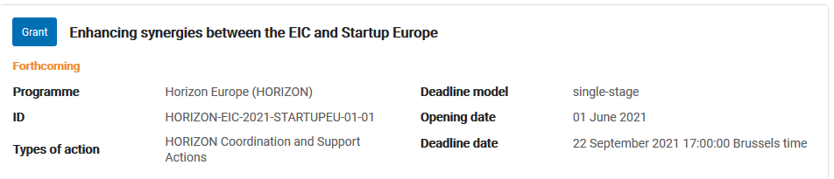
Call example

Slide 5
Deconstructing a call text
HORIZON-CL6-2021-BIODIV-01-11: What else is out there? Exploring the connection between biodiversity, ecosystems services, pandemics and epidemic risk
Topic ID
Expected EU contribution per project: between EUR 4 and 6 Million
Indicative budget: Total budget for the topic is EUR 12 Mililion
Type of Action: Research and Innovation Action
Eligibility conditions: see Annex B
Technology Readiness Level: Activities are expected to archive TLR 3-5
Specific Conditions
Successful proposal will contribute to European Green Deal priorities and the EU biodiversity strategy for 2030, whilst supporting the EU’s response to the coronavirus and other zoonotic outbreaks, in the context of EU’s goal of leading just digital, economic and ecological transitions that will leave no one behind, One Health approaches, and the future European Health Union. Projects results are expected to contribute to […]
Expected Outcome
Wildlife microbiomes, whether symbiotic, commensal or pathogenic, and their potential to spread by crossing interspecies barriers, eventually reaching humans via transitional interfaces (e.g. peri-urban, farming areas), are still largely unknown. […] The impacts of land use and climate change on biodiversity, ecosystem services and pandemics should be also taken into account, as well as any recent IPBES reports on the links between biodiversity and pandemics […]
Scope

Slide 6
Deconstructing a call text
HORIZON-CL6-2021-CLIMATE-01-06 Resilient livestock farming systems under climate change Specific conditions
Expected EU contribution per project | The EU estimates that an EU contribution of around EUR 12.00 million would allow these outcomes to be addressed appropriately. Nonetheless, this does not preclude submission and selection of a proposal requesting different amounts.
Indicative budget | The total indicative budget for the topic is EUR 12.00 million.
Type of Action | Research and Innovation Actions (RIA)

Slide 7

Deconstructing a call + example
Specific Conditions: main infromation about the call
Expected Outcomes: what is supposed to be achieved
Scope: presents what exactly is expected to be done
Outcomes …→ Impact
Research Work to be done
Consortium

Slide 8
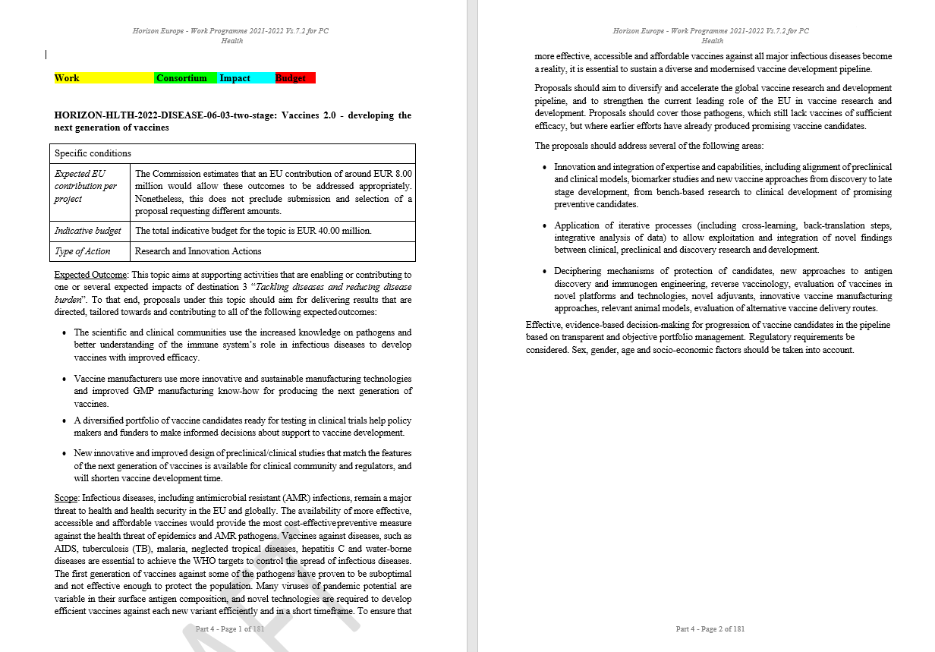

Slide 9
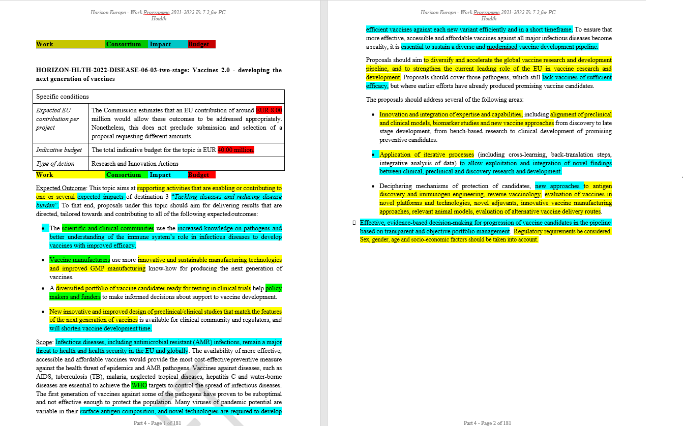

Slide 10
Group Work: Selecting and advertising HEU Calls for
Georgian Stakeholders
Research of relevant calls by using the respective working programmes and/or Search Tools (Funding & Tenders Portal)
    Focus on your clients/target group
  Decode and select the “right” calls
Develop mechanisms and strategies to present them to relevant stakeholders
    the research and innovation community in Georgia
    particular promising actors
Refine and present selected calls to Georgian stakeholders in a targeted
approach. Consider use of formats and media for each case!

Slide 11
Group Work: Core functions of NCP, current
measures and opportunities for Georgia
Divide into groups, consisting of both NCPs + Grants office representatives, targeting the priority fields, identified by TWINNING:
ICT (IT services, interoperability, AI, cybersecurity)
Art & Humanities / Cultural Heritage
Food and Agriculture (Food quality and safety, future farming, and new technologies
Renewable Energy (research capacity and infrastructure, green hydrogen, solar energy
Innovative Health System (research support, bacteriophages and herbal medicine)
Circular Economy/Waste Management
Summarise and describe your results and present to the whole group (select 1 person to do so)

Slide 12







Horizon Europe structure
Pillar I
Excellent Science
European Research Council
Mare Skłodowska-Curie
Research Infrastructures
Pillar II
Global Challenges & European Industrial Competitiveness
Health
Culture, Creativity & Inclusive Society
Civil Security for Society
Digital, Industry & Space
Climate, Energy & Mobility
Food, Bioeconomy, Natural Resources, Agriculture & Environment
Joint Research Centre
Pillar III
Innovative Europe
European Innovation Council
European Innovation Ecosystems
European Institute of Innovation & Technology
6 Clusters
Widening Participation and Strengthening the European Research Area
Widening participation & spreading excellence
Reforming & Enhancing the European R&I system

Slide 13








EU Twinning in Science-Business links
EU Georgia's Researchers' Mobility Programme
მადლობა ყურადღებისთვის
Thank You!

