Slide 1




SUPPORT TO GEORGIA’S RESEARCHERS’ MOBILITY
EURAXESS Georgia
For Mobile Researchers
This project is implemented on behalf of the EU by

Slide 2



EURAXESS
©Euraxess Georgia
2000 European Research Area (ERA) was launched
2004 ERA-MORE initiative launched
ERA-MORE - a network of Mobility Centres (MCs) throughout Europe, provide "proximity assistance to researchers and their families on all issues relating to their mobility (career development, viza, social security, tax, financial and family issues)".
2008 Researcher’s Mobility Portal Era-More becomes EURAXESS
EURAXESS - Researchers in Motion is to facilitate building a common European labour market of researchers by providing free information services, and timely and high-quality support to facilitate the relocation and career development of researchers in Europe. The EURAXESS serves as an implementation tool, translating ERA policies into everyday working practice.
2019 EURAXESS Georgia established
EURAXESS Georgia provides information and assistance by all means of this portal and with support of our national Service Centre to researchers who are coming to work in Georgia, as well as to researchers who are leaving for a foreign country.
2020 EURAXESS – ERA talent platform
An operational instrument for creation of a talent pipeline and strengthen knowledge circulation from Georgia to Iceland and from Portugal to Finland.

Slide 3
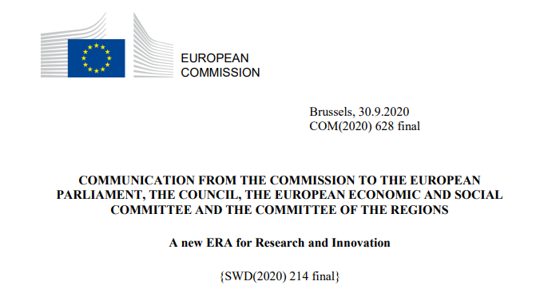
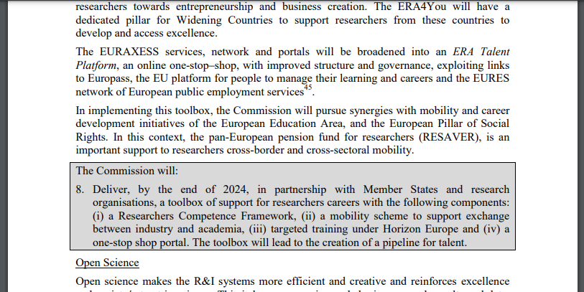
EURAXESS – ERA Talent Platform
©Euraxess Georgia

Slide 4




EURAXESS Georgia Network
©Euraxess Georgia
Bridge Head Organization
Shota Rustaveli national Foundation of Georgia
Partnership with Member States & Research Organizations
Researchers Competence Framework
Mobility Scheme to support exchange between industry and academia
Targeted Training under Horizon Europe
A one-stop Portal
EURAXESS Service Centre
Shota Rustaveli national Foundation of Georgia
EURAXESS Contact Points
6 Research Intensive Universities
https://www.youtube.com/watch?v=vXZyQ6pcHN0
@ Ivane Javakhishvili Tbilisi State University
@ Ilia State University
@ Georgian Technical University
@ Agricultural University of Georgia
@ Batumi Shota Rustaveli State University
@ Tbilisi State Medical University

Slide 5
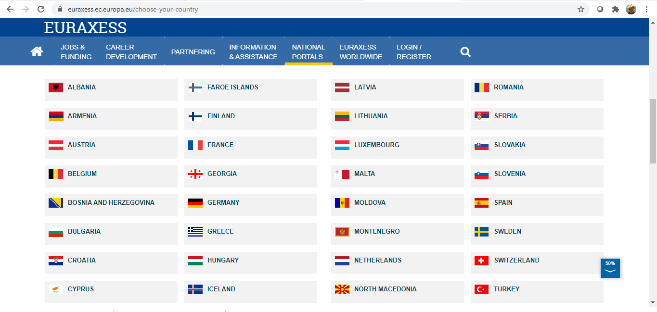
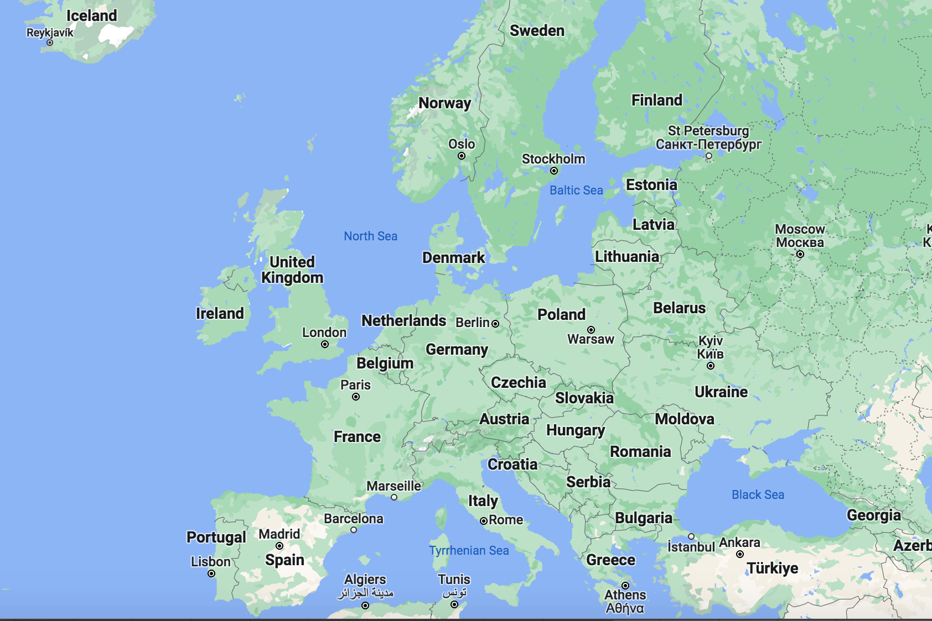
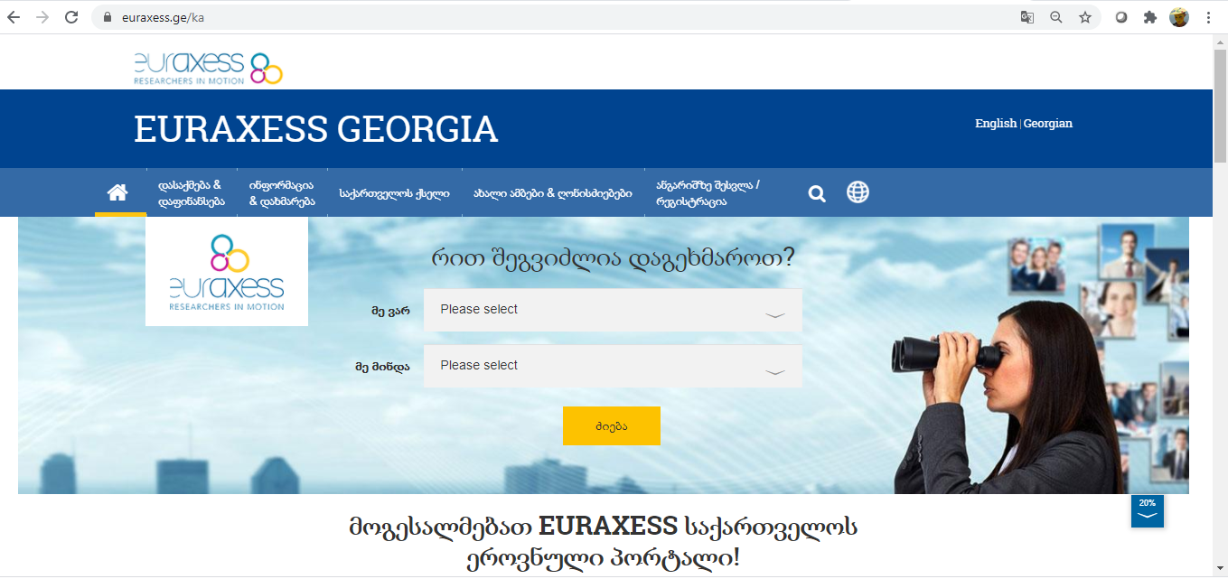
EURAXESS – Gateway to ERA
©Euraxess Georgia
https://www.euraxess.ge

Slide 6
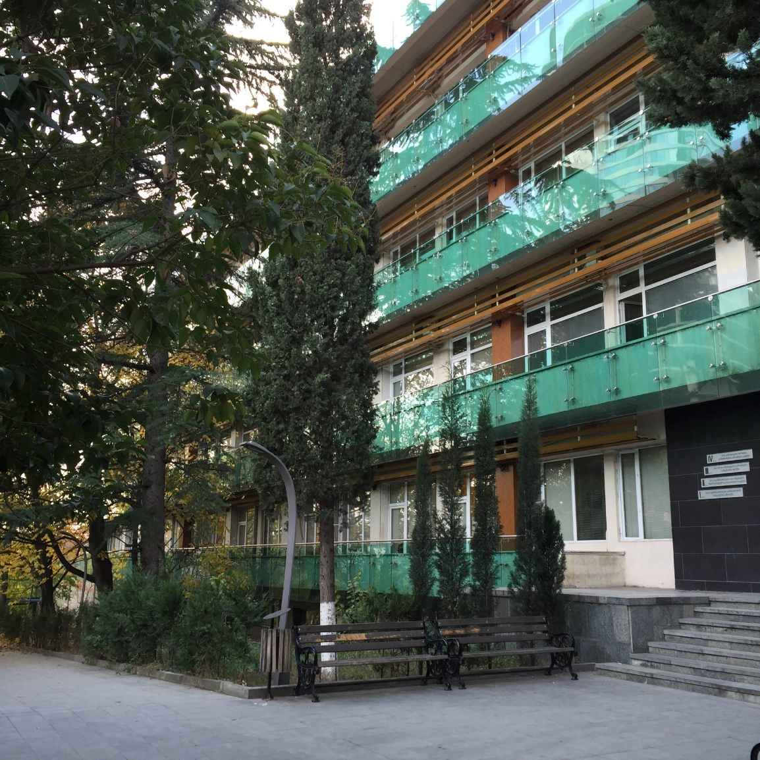




EURAXESS Georgia Links
©Euraxess Georgia
Facebook.com/
EuraxessGeorgia
@euraxessG
Youtube.com/
@Euraxessgeorgia1139
http://ec.europa.eu/euraxess
http://euraxess.ge
euraxess@rustaveli.org.ge
Visit ESC
@ Shota Rustaveli
National Science Foundation
Of GEORGIA
#euraxessgeorgia * #euraxess * #researchersinmotion

Slide 7


Thank You
❤ გმადლობთ ❤
иҭабуп

