Slide 1
Isabel Vergara
Bénédicte Charbonnel
How to prepare a successful proposal in Horizon Europe
24 March 2021

Slide 2
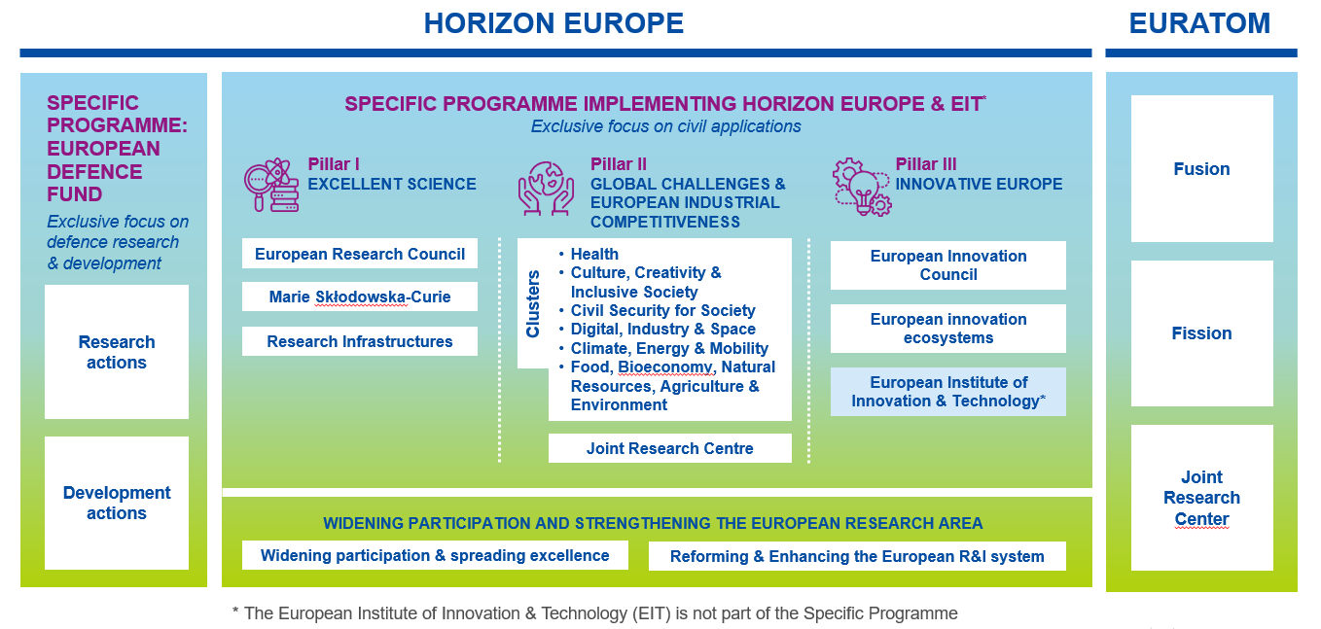
About Horizon Europe
Horizon Europe supports research and innovation through Work Programmes, which set out funding opportunities for research and innovation activities.

Slide 3
What is new in the submission process?
Horizon Europe

Slide 4

Admissibility
  Same general admissibility conditions
  Applications must be submitted before the call deadline, electronically via the Funding & Tenders Portal
  Applications must be complete, readable, accessible and printable, and include a plan for the exploitation and dissemination of results, unless provided otherwise in the specific call conditions.
  Proposal page limit
  Substantial reduction in maximum length:
  RIAs and IAs type of actions: limit for a full application is 45 pages
  CSAs: limit is 30 pages
  First stage proposals: limit is 10 pages
  EIC Pathfinder: limit is 17 pages
  Exceptions, if any, would be specified in the call text.

Slide 5

Eligibility
  Consortium composition (collaborative projects)
  at least one independent legal entity established in a Member State, and
  at least two other independent legal entities each established either in a different Member State or an Associated Country.
  Gender Equality Plan (applicable only from 2022 on)
  Participants that are public bodies, research organisations or higher education establishments from Members States and Associated countries must have a gender equality plan, covering minimum process-related requirements.
  A self-declaration will be requested at proposal stage (for all types of participants).
  Included in the entity validation process (based on self-declaration)

Slide 6



Who is eligible for funding?
  EU countries
  Member States (MS) including their outermost regions
  The Overseas Countries and Territories (OCTs) linked to the MS.
  Non-EU countries
  Countries associated to Horizon Europe (AC)
  Low and middle income countries: See HE Programme Guide.
  Other countries when announced in the call or exceptionally if their participation is essential
  Specific cases
  Affiliated entities established in countries eligible for funding.
  EU bodies
  International organisations (IO):
    International European research organisations are eligible for funding.
    Other IO are not eligible (only exceptionally if participation is essential)
    IO in a MS or AC are eligible for funding for Training and mobility actions and when announced in the call conditions

Slide 7
Associated Countries
For the purposes of the eligibility conditions, applicants established in Horizon 2020 Associated Countries or in other third countries negotiating association to Horizon Europe will be treated as entities established in an Associated Country, if the Horizon Europe association agreement with the third country concerned applies at the time of signature of the grant agreement.
  Specific situation of UK
  The UK is expected to soon become an associated country to Horizon Europe. UK entities can take part in the first calls for proposals of Horizon Europe
  The UK is associating to the full Horizon Europe programme with the only exception of the EIC Fund (which is the loan/equity instrument of the EIC).

Slide 8

Activities eligible for funding
  Eligible activities are the ones described in the call conditions
  Activities must focus exclusively on civil applications and must not:
    aim at human cloning for reproductive purposes;
    intend to modify the genetic heritage of human beings which could make such changes heritable (except for research relating to cancer treatment of the gonads, which may be financed);
    intend to create human embryos solely for the purpose of research, or for the purpose of stem cell procurement, including by means of somatic cell nuclear transfer;
    lead to the destruction of human embryos.

Slide 9
Activities eligible for funding – Type of actions
Research and innovation action (RIA)
Innovation and market deployment actions (IMDA)
Activities to establish new knowledge or to explore the feasibility of a new or improved technology, product, process, service or solution.
Activities that embed an innovation action and other activities necessary to deploy an innovation on the market. (EIC)
Innovation action (IA)
Training and mobility actions (TMA)
Activities to produce plans and arrangements or designs for new, altered or improved products, processes or services.
Activities that aim to improve the skills, knowledge and career prospects of researchers, based on mobility between countries and, if relevant, between sectors or disciplines. (MSCA)
Coordination and support actions (CSA)
Pre-commercial procurement actions/ (PCP)
Activities that contribute to the objectives of Horizon Europe. This excludes R&I activities, except for ‘Widening participation and spreading excellence’
Activities that aim to help a buyers’ group to strengthen the public procurement of research, development, validation and, possibly, the first deployment of new solutions
Public procurement of innovative solutions actions (PPI)
Programme co-fund actions (CoFund)
Public procurement of innovative solutions actions (PPI)
A programme of activities established or implemented by legal entities managing or funding R&I programmes, other than EU funding bodies.
Activities that aim to strengthen the ability of a buyers’ group to deploy innovative solutions early

Slide 10
Maximum funding rates
Type of Action | Funding rate
Research and innovation action | 100%
Innovation action | 70% (except for non-profit legal entities, where a rate of up to 100% applies)
Coordination and support action | 100%
Programme co-fund action | Between 30% and 70%
Innovation and market deployment | 70% (except for non-profit legal entities, where a rate of up to 100% applies)
Training and mobility action | 100%
Pre-commercial procurement action | 100%
Public procurement of innovative solutions action | 50%
Other funding rates may be set out in the specific call conditions

Slide 11


Application form (proposal template)
  Same structure
  The proposal contains two parts:
  Part A (web-based forms) is generated by the IT system. It is based on the information entered by the participants through the submission system in the Funding & Tenders Portal.
  Part B is the narrative part that includes three sections that each correspond to an evaluation criterion. Part B needs to be uploaded as a PDF document following the templates downloaded by the applicants in the submission system for the specific call or topic.

Slide 12



  New features in the Horizon Europe proposal
  New fields in part A
  Researchers table – needed to follow up researchers careers (HE indicator)
  Role of participating organisation
  Self-declaration on gender equality plan
  Fields moved from part B to part A
  Ethics self-assessment
  Security questionnaire (NEW! in all HE proposals)
  Information on participants’ previous activities related to the call
  New in part B
  Glossary of terms.
  Consistency on the use of terminology is ensured in all project phases (from WP to proposal and reporting)
  Extensive explanations on what exactly should be included in each section.

Slide 13
What is new in the evaluation process?
Horizon Europe

Slide 14

Evaluation (award) criteria
  Same criteria as in H2020
  Same three award criteria: ‘Excellence’, ‘Impact’ and ‘Quality and efficiency of the implementation’. Excellence only for ERC.
  Adapted following lessons learnt
  The number of ‘aspects to be taken into account’ have been reduced, ensuring that the same aspect is not assessed twice
  Open Science practices assessed as part of the scientific methodology in the excellence criterion
  New approach to impact: Key Impacts Pathways (KIPs)
  The assessment of the quality of applicants is assessed under ‘implementation’, rather than as a separate binary assessment of operational capacity
  Assessment of management structures has been removed.

Slide 15

Evaluation criteria (RIAs and IAs)
Excellence
Clarity and pertinence of the project’s objectives, and the extent to which the proposed work is ambitious, and goes beyond the state-of-the-art.
Soundness of the proposed methodology, including the underlying concepts, models, assumptions, inter-disciplinary approaches, appropriate consideration of the gender dimension in research and innovation content, and the quality of open science practices including sharing and management of research outputs and engagement of citizens, civil society and end users where appropriate.
IMPACT
Credibility of the pathways to achieve the expected outcomes and impacts specified in the work programme, and the likely scale and significance of the contributions due to the project.
Suitability and quality of the measures to maximize expected outcomes and impacts, as set out in the dissemination and exploitation plan, including communication activities.
Quality and efficiency of the implementation
Quality and effectiveness of the work plan, assessment of risks, and appropriateness of the effort assigned to work packages, and the resources overall.
Capacity and role of each participant, and extent to which the consortium as a whole brings together the necessary expertise.
Proposals aspects are assessed to the extent that the proposed work is within the scope of the work programme topic

Slide 16
Standard evaluation process
Individual evaluation
Consensus group
Panel review
Finalisation
Experts assess proposals individually. Minimum of three experts per proposal (but often more than three).
All individual experts discuss together to agree on a common position, including comments and scores for each proposal.
The panel of experts reach an agreement on the scores and comments for all proposals within a call, checking consistency across the evaluations.
if necessary, resolve cases where evaluators were unable to agree.
Rank the proposals with the same score
The Commission/Agency reviews the results of the experts’ evaluation and puts together the final ranking list.

Slide 17
  Piloting new processes based on lessons learnt
Individual evaluation
Consensus group
Panel review
Finalisation
Reaction
Right-to-react (Rebuttal)
  Objective is to increase transparency, to correct any factual or major misunderstandings by experts at an early stage, and provide more detailed feedback to applicants.
  Applicants will send their reactions to draft experts comments
  Experts will take applicants’ reaction into account before finalising their final assessment.

Slide 18

  Piloting new processes based on lessons learnt
Blind evaluation (in 1st stage)
  There is no evidence that the current proposal evaluation system is systematically biased.
  There are understandable concerns that evaluation experts may be swayed – perhaps unconsciously – in favour of proposals from well-known organisations in countries with better performing R&I systems.
  ‘Blind’ evaluation is a way to remove any real or perceived effect of such reputational bias.
  Experts evaluate without knowing the identity of participants.
  The work programme will include an additional admissibility criterion: applicants can not be disclosed in the narrative part of the proposal.

Slide 19
Ethics review
  Same criteria as in H2020
  For all activities funded, ethics is an integral part of research from beginning to end, and ethical compliance is essential to achieve real research excellence. An ethics review process is carried out systematically in all Horizon Europe proposals, based on a self-assessment included in the proposal.
  Ethical research conduct implies the application of fundamental ethical principles and legislation in all possible domains of research. This includes the adherence to the highest standards of research integrity as described in the European Code of Conduct for Research Integrity.
  Adapted following lessons learnt
  Focus mainly on complex/serious cases
  Reduce number of ethics requirements in funded projects.

Slide 20



Security scrutiny
  New in Horizon Europe
  Security issues will be checked systematically in all Horizon Europe proposals (in H2020 only proposals submitted to topics flagged as ‘security-sensitive’ were checked). The checks are based on a self-assessment included in the proposal. The focus is on:
  Whether the proposal uses or generates EU classified information
  Potential of misuse of results (that could be channeled into crime or terrorism)
  Whether activities involve information or materials subject to national security restrictions
  The checks based on the self-assessment may trigger an in-depth security scrutiny.

Slide 21
Points to consider when writing a proposal in HE
Horizon Europe

Slide 22







Key principles
Updated slide (June 2021)
Your proposed work must be within the scope of a work programme topic
You need to demonstrate that your idea is ambitious and goes beyond the state of the art
Your scientific methodology must take into account interdisciplinary, gender dimension and open science practices.
You should show how your project could contribute to the outcomes and impacts described in the work programme (the pathway to impact)
You should describe the planned measures to maximise the impact of your project (‘plan for the dissemination and exploitation including communication activities’)
You should demonstrate the quality of your work plan, resources and participants

Slide 23




Policy and horizontal considerations
Updated slide (June 2021)
Open Science across the programme
These aspects must normally be considered in all Horizon Europe calls (unless explicitly mentioned in the topic description).
Specific calls may include other aspects to take into account.
Future webinars focused on these specific aspects will come soon.
Gender dimension in R&I content
Pathway to impact
Measures to maximise impact
Artificial intelligence

Slide 24
Open Science across the programme
Open science is an approach based on open cooperative work and systematic sharing of knowledge and tools as early and widely as possible in the process. Including active engagement of society
Open
Science
Mandatory immediate Open Access to publications: beneficiaries must retain sufficient IPRs to comply with open access requirements;
Data sharing as ‘open as possible, as closed as necessary‘: mandatory Data Management Plan for FAIR (Findable, Accessible, Interoperable, Reusable) research data
Work Programmes may incentivize or oblige to adhere to open science practices such as involvement of citizens, or to use the European Open Science Cloud
Assessment of open science practices through the excellence award criteria for proposal evaluation. Under quality of participants previous experience on open sciences practices will be evaluated positively.
Dedicated support to open science policy actions
Open Research Europe publishing platform

Slide 25

Gender dimension in R&I content
Addressing the gender dimension in research and innovation entails taking into account sex and gender in the whole research & innovation process.
Gender Dimension
The integration of the gender dimension into R&I content is mandatory, unless it is explicitly mentioned in the topic description
Why is gender dimension important?
Why do we observe differences between women and men in infection levels and mortality rates in the COVID-19 pandemic?
Does it make sense to study cardiovascular diseases only on male animals and on men, or osteoporosis only on women?
Does it make sense to design car safety equipment only on the basis of male body standards?
Is it responsible to develop AI products that spread gender and racial biases due to a lack of diversity in the data used in training AI applications?
Is it normal that household travel surveys, and thus mobility analysis and transport planning, underrate trips performed as part of caring work?
Did you know that pheromones given off by men experimenters, but not women, induce a stress response in laboratory mice sufficient to trigger pain relief?
And did you know that climate change is affecting sex determination in a number of marine species and that certain populations are now at risk of extinction?

Slide 26
Describing the impact of your proposal
…by thinking about the specific contribution the project can make to the expected outcomes and impacts set out in the Work Programme.
Project’s pathway towards impact
Work Programme outcome: “Innovative accessibility and logistics solutions applied by the European Transport sector”
Work Programme impact : “Seamless, smart, inclusive and sustainable mobility services”
PROJECT’S RESULTS
INPUTS
DISSEMINATION & EXPLOITATION
PROJECT’S CONTRIBUTION TO THE EXPECTED OUTCOME
PROJECT’S CONTRIBUTION TO THE EXPECTED IMPACT
HE grant, human resources, expertise, etc.
Successful large-scale demonstration trial with 3 airports of an advanced forecasting system for proactive airport passenger flow management
At least 9 European airports adopt the advanced forecasting system that was demonstrated during the project
Increase max. passenger capacity by 15% and passenger average throughput by 10%, leading to a 28% reduction in infrastructure expansion costs
Other project results
Other expected outcomes
Other expected impacts
Implementation
Effects

Slide 27
Link between policy priorities and project results
Strategic Planning and Programming (EC)
EU POLICY PRIORITIES | Overall priorities of the European Union (Green Deal, Fit for the Digital Age,…)
KEY STRATEGIC ORIENTATIONS | Set of strategic objectives within the EC policy priorities where R&I investments are expected to make a difference
IMPACT AREAS | Group of expected impacts highlighting the most important transformation to be fostered through R&I
EXPECTED IMPACTS = DESTINATIONS | Wider long term effects on society (including the environment), the economy and science, enabled by the outcomes of R&I investments (long term). It refers to the specific contribution of the project to the work programme expected impacts described in the destination. Impacts generally occur some time after the end of the project.
EXPECTED OUTCOMES = TOPICS | The expected effects, over the medium term, of projects supported under a given topic. The results of a project should contribute to these outcomes, fostered in particular by the dissemination and exploitation measures. This may include the uptake, diffusion, deployment, and/or use of the project’s results by direct target groups. Outcomes generally occur during or shortly after the end of the project.
PROJECT RESULTS
STRATEGIC PLAN
WORK PROGRAMME
PROJECT PROPOSALS
Application process (researchers)

Slide 28

Measures to maximise impact
To include a draft plan in proposal is an admissibility condition, unless the work programme topic explicitly states otherwise.
Dissemination, exploitation and communication
All measures should be proportionate to the scale of the project, and should contain concrete actions to be implemented both during and after the end of the project
Elements of the D&E&C plan
Planned measures to maximise the impact of projects
Target groups (e.g. scientific community, end users, financial actors, public at large) and proposed channels to interact
Communication measures for promoting the project and its findings throughout the full lifespan of the project
Policy feedback measures to contribute to policy shaping and supporting the implementation of new policy initiatives and decisions
Follow-up plan to foster exploitation/uptake of the results
    Comprehensive and feasible strategy for the management of the intellectual property (the provision of a results ownership list is mandatory at the end of the project)
    If exploitation is expected primarily in non-associated third countries, give a convincing justification that this is still in the Union’s interest.

Slide 29







Do no significant harm principle (DNSH)
Updated slide (June 2021)
In line with the European Green Deal objectives, economic activities should not make a significant harm to any of the six environmental objectives (EU Taxonomy Regulation)
European Green Deal
The six environmental objectives :
    Applicants can refer to the DNSH principle when presenting their research methodology and the expected impacts of the project, to show that their project will not carry out activities that make a significant harm to any of the six environmental objectives of the EU Taxonomy Regulation.
    However, evaluators will not score applications in relation to their compliance with the DNSH principle unless explicitly stated in the work programme (currently, this is the case only for actions in the European Innovation Council Work Programme 2021).
Climate change mitigation
Sustainable use & protection of water & marine resources
Pollution prevention & control
Climate change adaptation
Transition to a circular economy
Protection and restoration of biodiversity & ecosystems

Slide 30

Artificial intelligence
Due diligence is required regarding the trustworthiness of all AI-based systems/ techniques used or developed in projects funded under Horizon Europe.
Trustworthy Artificial Intelligence
Under Horizon Europe, the technical robustness* of the proposed AI based systems must be evaluated under the excellence criterion.
(*) Technical robustness refers to technical aspects of AI systems and development, including resilience to attack and security, fullback plan and general safety, accuracy, reliability and reproducibility.
AI-based systems or techniques should be, or be developed to become:
Technically robust, accurate and reproducible, and able to deal with and inform about possible failures, inaccuracies and errors, proportionate to the assessed risk posed by the AI-based system or technique.
Socially robust, in that they duly consider the context and environment in which they operate.
Reliable and function as intended, minimizing unintentional and unexpected harm, preventing unacceptable harm and safeguarding the physical and mental integrity of humans.
Able to provide a suitable explanation of its decision-making process, whenever an AI-based system can have a significant impact on people’s lives.

Slide 31
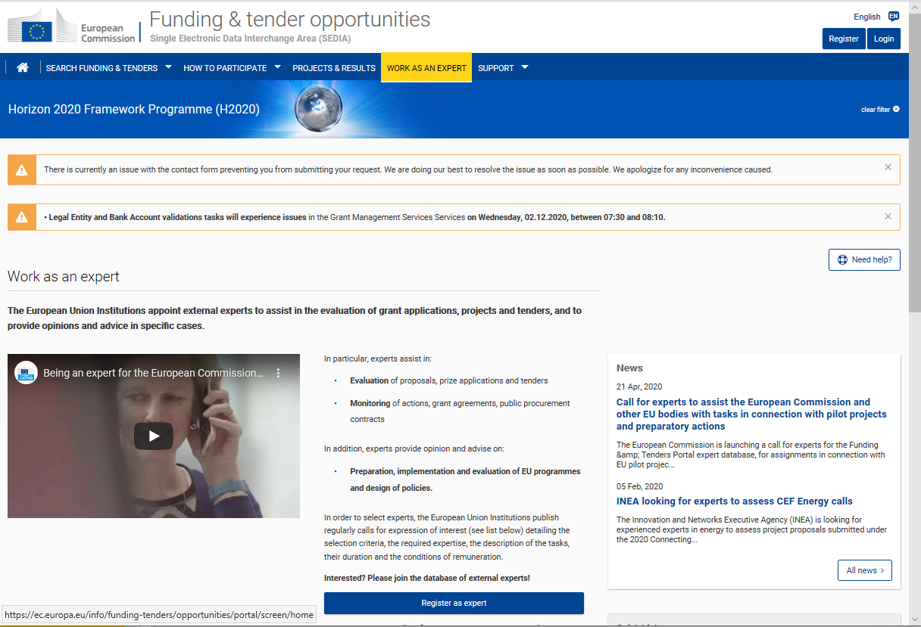
… one final point
The best way to learn is by doing
You can register in the EU experts database at any time.
Click here to register!

Slide 32



Any questions?
Please enter your questions in slido https://app.sli.do/event/h8eseiw4

Slide 33
Thank you!
# HorizonEU
http://ec.europa.eu/horizon-europe

