Slide 1
Dr. Nino Parsadanishvili
Widening Information Day
October 13, 2022

Slide 2
Structure
General Overview
Calls for Applications Covered by Presentation
Teaming
European Excellence Initiative
Recommendations to Consider for Proposal Preparation

Slide 3
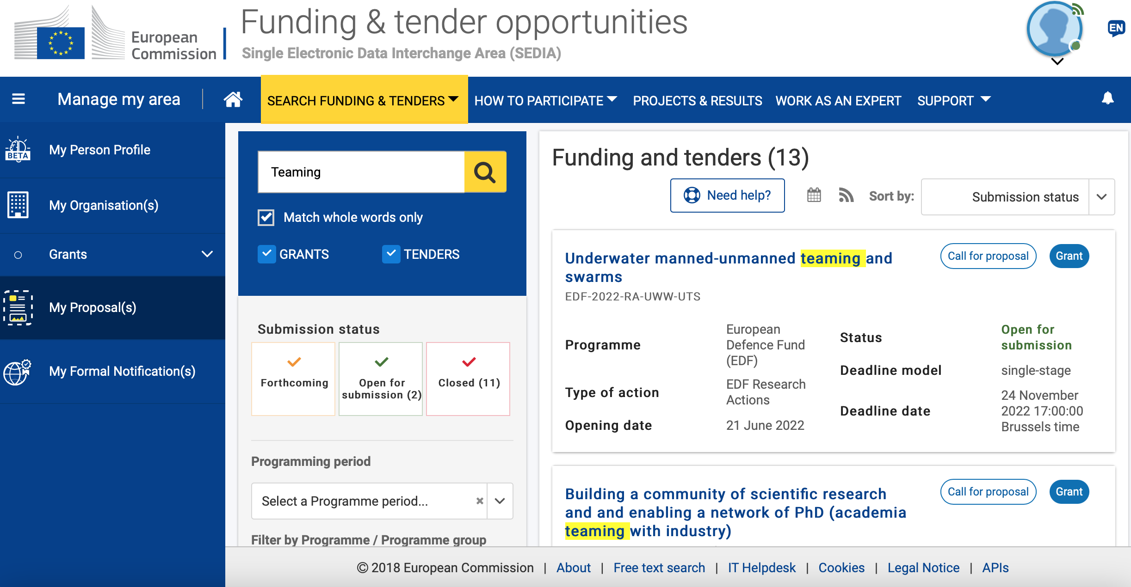
General Overview - Finding Call on the Portal

Slide 4
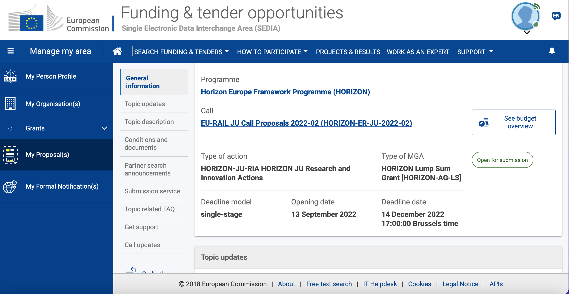
General Overview - Exploring call related information on the portal

Slide 5
Teaming - Structure
Call for Applications - Building a community of scientific research and and enabling a network of PhD (academia teaming with industry)
Deadline: 14 December 2022 17:00:00 Brussels time
Budget: 1,300 000
General conditions
Admissibility conditions
Eligible countries
Other eligibility conditions
Evaluation and award
Award criteria, scoring and thresholds
Submission and evaluation processes

Slide 6
Teaming – General Conditions
Admissibility conditions
submitted before the call deadline
submitted electronically via the Funding & Tenders Portal
Applications must be complete
Applications must be readable, accessible and printable
Applications must include a plan for the exploitation and dissemination of results including communication activities

Slide 7
Teaming – General Conditions
Eligibility
Entities eligible to participate
Any legal entity, regardless of its place of establishment, including legal entities from non- associated third countries or international organisations (including international European research organisations1) is eligible to participate (whether it is eligible for funding or not), provided that the conditions laid down in the Horizon Europe Regulation have been met, along with any other conditions laid down in the specific call topic.
Eligible countries
the Member States of the European Union, including their outermost regions;
non-EU countries

Slide 8
Teaming – Evaluation and Award
Award criteria, scoring and thresholds
Excellence
Impact
Quality and efficiency of the implementation
For full applications, each criterion will be scored out of 5. The threshold for individual criteria will be 3. The overall threshold, applying to the sum of the three individual scores, will be 10.
Electronic Submission Through Funding and Tenders Portal

Slide 9
European Excellence Initiative - EEI
Through the European Excellence Initiative (EEI), Horizon Europe’s support aims at the transformation of higher education sector and their surrounding ecosystems, including non-university research centres.
EEI Unifies Various Calls for Applications:
Example:
Capacity building to strengthen networks of higher education institutions and cooperation with surrounding ecosystems

Slide 10
Capacity Building to strengthen networks of higher education institutions and cooperation with surrounding ecosystems
Deadline: Call is closed
Total Budget: 30 000 000
General conditions
Admissibility conditions
Eligible countries
Other eligibility conditions
Evaluation and award
Award criteria, scoring and thresholds
Submission and evaluation processes
All listed conditions are the same with teaming call for applications

Slide 11
Recommendations to Consider
Partner Search
Project Structure:
Simple Text
Avoid duplications between work plan tables
Consider policy requirements
Ethics requirements (if any) are binding
Takeaway messages:
Pay attention to deadlines;
Pay attention to Call Specific Requirements
Be proactive
Develop Mitigation Strategy

Slide 12
Thank you for your attention
Questions?
Comments?

